Slide 1
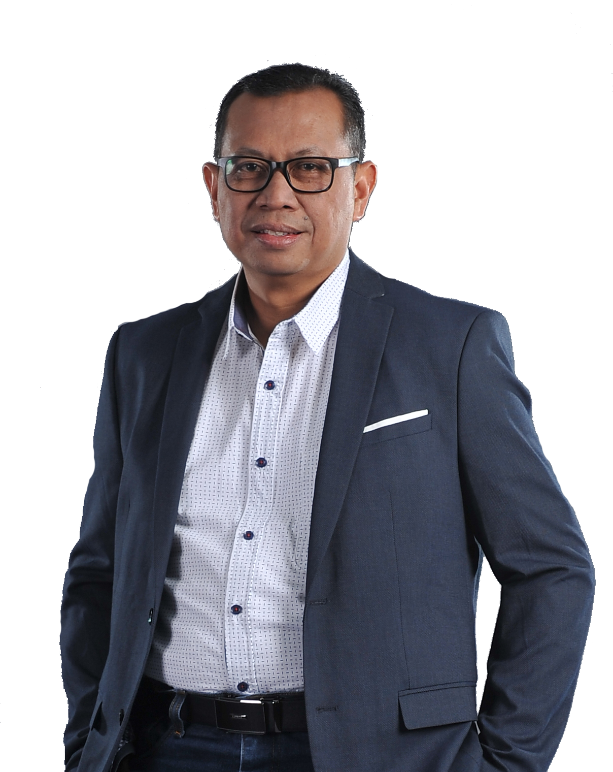

Pendidikan
Institut Teknologi Bandung – Teknik Sipil 1986
BPST – EP V
International HSSE Training Chevron Texaco, USA
Oil Spill Response, Texas A&M Univ,USA
Fire Fighting, Collage Station Univ, USA
Karir
VP HSSE - PHE
VP QHSSE – PDSI
HSSE Manager – PHE JOB PTJM
HSSE Manager – PHE BOB BSP
Manager PLM – PGE Kamojang
Manager PKBL – PEP Balikpapan
Manager PLM – PEP Bunyu
Kepala LK3 – PGE Kamojang
Rio Dasmanto
Direktur Utama
Bandung, 1967
PERTAMINA DRILLING SERVICES INDONESIA
@pdsi.pertamina

