Slide 2
SELAMAT BERPRESTASI…
No. | Nama Tim | Judul Ide
1 | TIM SIMPRU | Sistem Informasi Peminjaman Ruangan ITS
 | Bestari | Meeting room booking system
2 | Semut Hitam | Sistem Presensi Berbasis Online Menggunakan Smart Finger Electronic Keylock System
 | SI 3R | Aplikasi Absensi Online Monitoring Perkuliahan Mahasiswa dan Dosen Mengajar
3 | Honey Bee | Efektivitas Perkuliahan Berbasis E-monitoring sebagai Upaya Pengembangan MB-APP di Departemen Manajemen Bisnis ITS
4 | Positif People | Employee Care Centre
5 | Barokah | Day Care ITS
6 | Tim Sapu Bersih | Peningkatan Efektivitas Penerimaan Distribusi Paket Melalui e-paket di lingkungan ITS
7 | KAIZEN for ITS | Data bebas pustaka pada Sim Yudisium
8 | Raja Prestasi | Cepat Tanggap: Sistem Helpdesk Online
9 | Renewable Energy | Sistem Monitoring Energi
10 | BME-TEAM2 | Pengembangan Sistem Pengunci dan Manajemen Energi Ruang Kelas Otomatis

Slide 3
PENDAMPINGA #1 ITSprovement! 2017
DILO ITS
6 Oktober 2017
#TendikITSKreatif
#KonteribusiNyataBuatITS
#ITS_PTNBH_Berinovasi

Slide 4
Our Jorney to bring ITS Bigger
31 Okt-1 Nov
17 Nopember
1 Desember
7 Desember
4 Oktober
Pendampingan #1
Meet the Experts
Pendampingan #3
Pengumpulan Laporan
ITSprovement Awards
20 Oktober
Pendampingan #2
6 Desember
Penjurian Akhir
#TendikITSKreatif
#KonteribusiNyataBuatITS
#ITS_PTNBH_Berinovasi

Slide 5
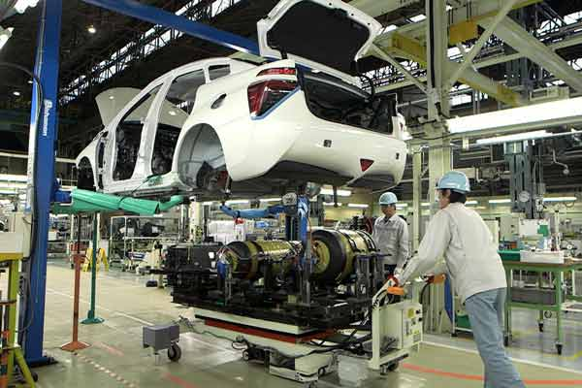
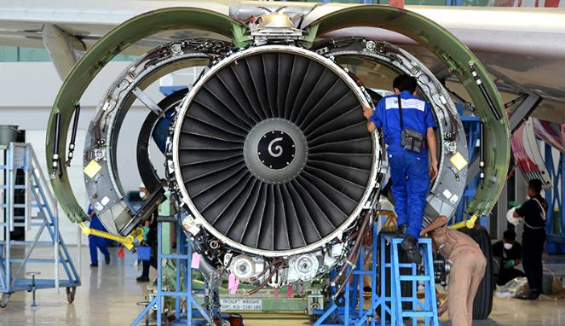
Meet the Experts 2017
31 Oktober 2017
1 Nopember 2017

Slide 6
6 Langkah Implementasi Ide Perbaikan
1. Menemukan Persoalan / Tema
2. Menetapkan Target
3. Melakukan Analisa Kondisi yang Ada
4. Melakukan Analisa Sebab Akibat
5. Merencanakan Penanggulangan
6. Melaksanakan Penanggulangan
7. Memeriksa (Evaluasi) Hasil Penanggulangan
8. Standarisasi dan Rencana Berikut

Slide 7
7 Alat Bantu (Seven Tools)
Check sheet
Pareto Chart
Control Chart
Scatter Diagram
Stratifikasi atau Flowchart
Histogram
Fishbone Diagram

Slide 8
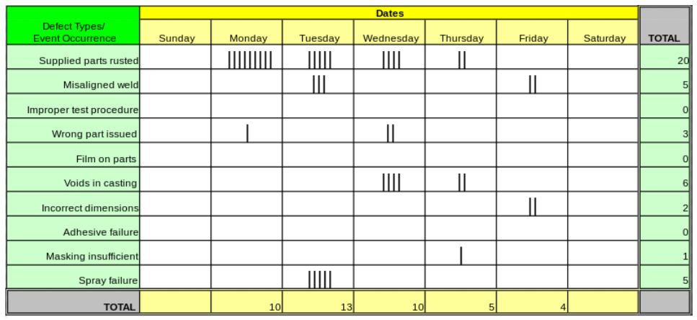
Check sheet
The check sheet is a simple document that is used for collecting data in real-time and at the location where the data is generated

Slide 9
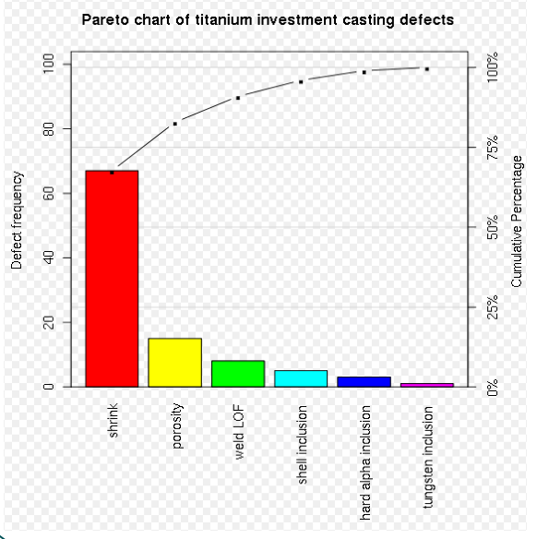
Pareto Chart
Pareto chart, named after Vilfredo Pareto, is a type of chart that contains both bars and a line graph, where individual values are represented in descending order by bars, and the cumulative total is represented by the line.

Slide 10
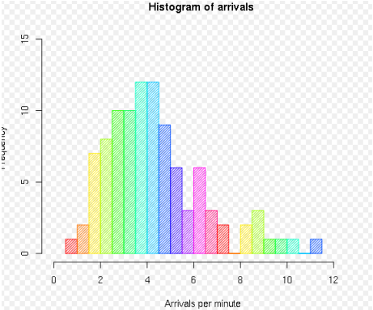
Histogram
In Statistics, a histogram is a graphical representation showing a visual impression of the distribution of data

Slide 11
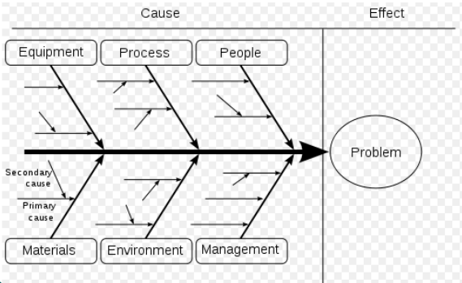
Fishbone Diagram
Common uses of the Ishikawa diagram are product design and quality defect prevention, to identify potential factors causing an overall effect.

Slide 12
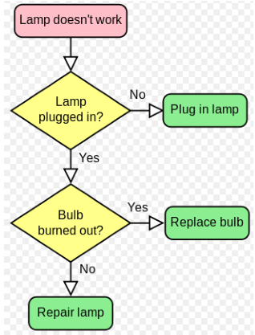
Stratification or Flow chart
A flowchart is a type of diagram that represents an algorithm or process, showing the steps as boxes of various kinds, and their order by connecting these with arrows

Slide 13
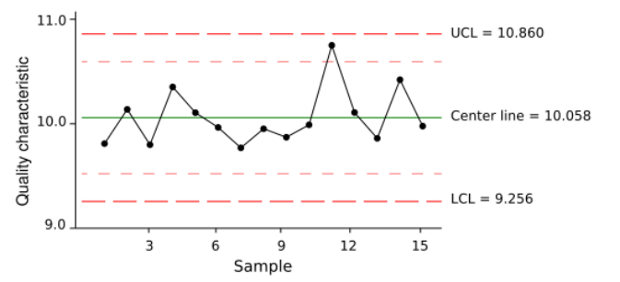
Control Chart
Control charts, also known as process-behavior charts, in SPC are tools used to determine whether a manufacturing

Slide 14
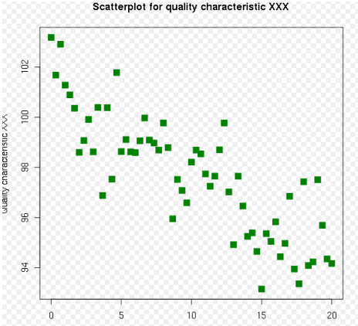
Scatter Diagram
Scatter plot or scatter graph is a type of Mathematical diagram using Cartesian coordinates to display values for two variable for a set of data.

Slide 15
Template Dokumen Improvement 2017

Slide 16
Terima Kasih

Slide 17
“PEMBUATAN APLIKASI PEMINJAMAN RUANG”
NAMA TIM
UNIT KERJA TIM
Kode Team

Slide 18
PROFIL TIM

Slide 19
ANALISIS KONDISI YANG ADA

Slide 20
PEMILIHAN TEMA

Slide 21
ANGGARAN DANA IMPLEMENTASI

Slide 22
Prosedur Pengajuan Dana Implementasi
Pengajuan RAB rinci | 10 Oktober
Pembuatan dan Penandatanganan Kontrak Implementasi Ide | 12 Oktober
Pengumpulan laporan tahap I (75%) | 11 Oktober
Pengajuan pencairan dana tahap I oleh SDMO | 11 Oktober
Pengumpulan laporan tahap II (25%) | 10 Nopember
Pengajuan pencairan dana tahap II oleh SDMO | 13 Nopember
Pengumpulan SPJ dan Laporan Akhir | 4 Desember

Slide 23
Terima Kasih
#kontribusiNyataBuatITS

