Slide 1

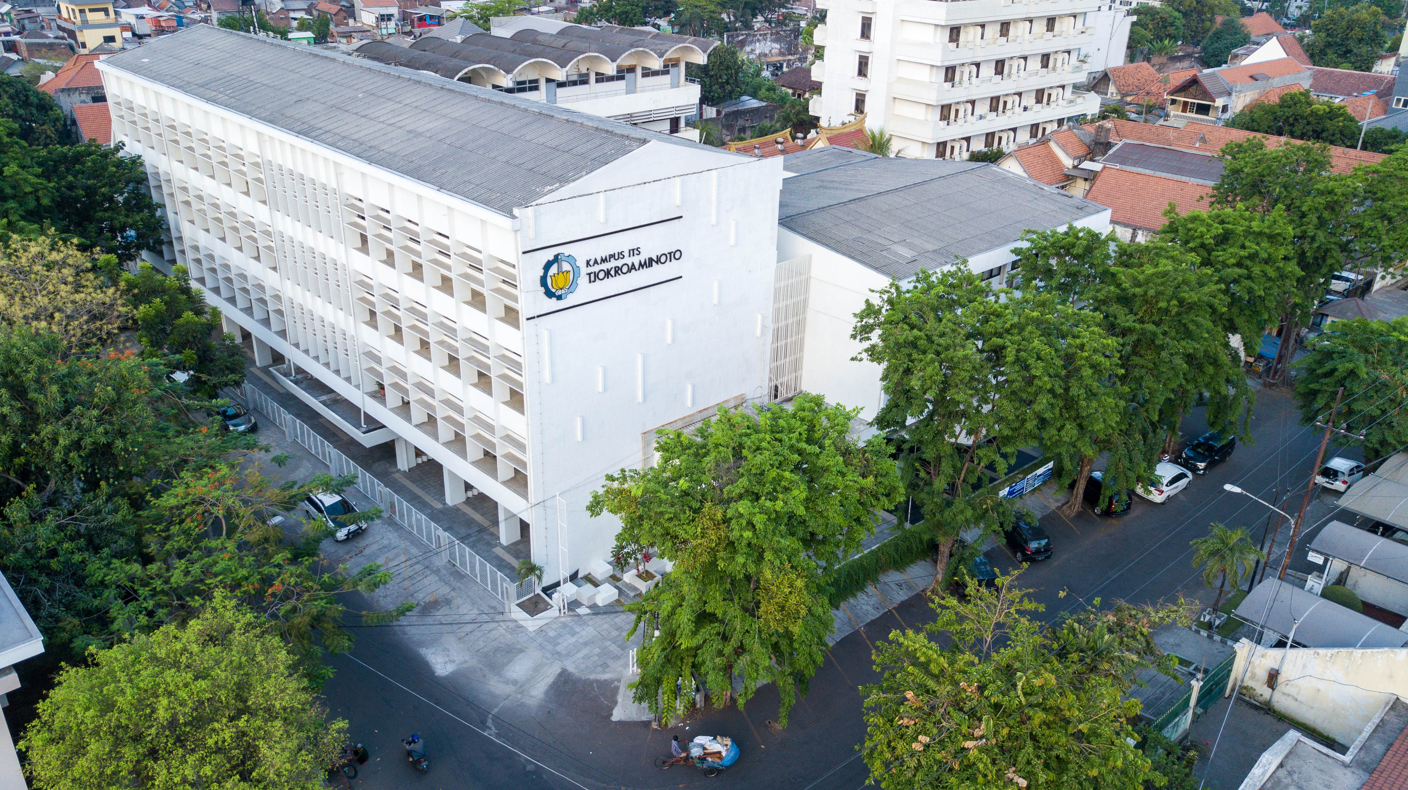



THE 4TH INTERNATIONAL CONFERENCE ON MANAGEMENT OF
TECHNOLOGY, INNOVATION AND PROJECT
Your Name
Affiliation
“Insert Tittle Here”
Tjokroaminoto ITS Campus
Cokroaminoto Street 12A, Surabaya 60264
Tel: +62315613922, +62315666172 | E-mail: info@mmt.its.ac.id

Slide 2

Insert Tittle Here
THE 4TH INTERNATIONAL CONFERENCE ON MANAGEMENT OF TECHNOLOGY, INNOVATION AND PROJECT

Slide 8

THANK YOU
THE 4TH INTERNATIONAL CONFERENCE ON MANAGEMENT OF TECHNOLOGY, INNOVATION AND PROJECT
“Your Quotes”
Your Name
Affiliation

