Slide 1
CALL FOR PARTNERSHIP
The 3rd International Conference on Business and Management Technology (3rd IConBMT 2021)
Online Conference, July 31st 2021
bit.ly/IConBMT2021

Slide 2
rd
The 3 IConBMT
The 3rd International Conference on Business and Management Technology (3rd IConBMT 2021)
Organizer & Committee
Online Conference, July 31st 2021
General Chair Dr. Ir. Janti Gunawan MEngSc, MComIB
Institut Teknologi Sepuluh Nopember, Indonesia
The massive disruptions of the COVID-19 pandemic have accelerated the rise of digital business. Innovation and resilience are needed to achieve a thriving business. The 3rd International Conference on Business and Management of Technology (IConBMT) will facilitate knowledge sharing and fruitful discussion amongst scholars, researchers, and practitioners that combine business, management, management technology, entrepreneur, and sociopreneurs. The conference will explore the theme of “Back on track post-COVID-19 Pandemic: How agile is your business?” This conference will bring together ideas, knowledge, problems, research findings, and insights from expert experiences for raising agility in the industry.

Slide 3
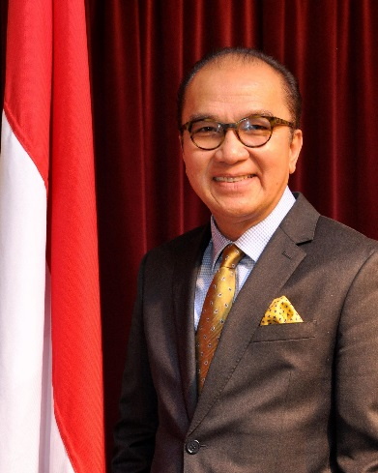
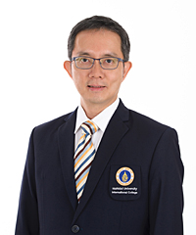
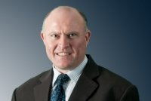
Mr. Tantowi Yahya
Indonesian Ambassador to New Zealand, Samoa and Tonga
Assoc. Prof. Dr. Yingyot Chiaravuthi
Chair of South East Asia Chapter – Academy of International Business
Mahidol University International College, Thailand
Prof. James Stanworth
National Cheng Kung University, Taiwan

Slide 4
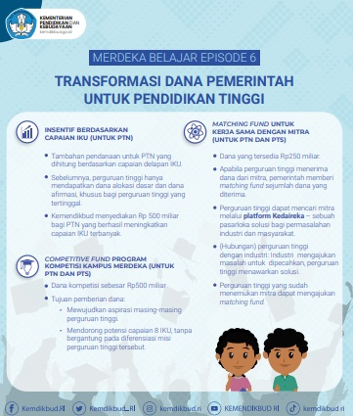
WHY JOIN OUR CONFERENCE and BE OUR PARTNER?

Slide 5
CALL FOR PARTNERSHIP
To improve the quality of our research and university

Slide 6
Conference Scope
In line with the conference theme, this conference invite research papers and case studies in the following areas but not limited to:
Track 1: Strategic, Operational and Digital Business
Track 2 : Marketing Management
Track 3 : Human Resource Management
Operations Management
Supply Chain Management
Business Process Management
Business Modelling and Management
Research and Technology Commercialization
Risk Management
Strategic and Policy Management
Business Analytics
Management Aspects of Information and Computation Technology
Management of Technology
Strategic Marketing
Service Marketing
Brand Management
Consumer Behavior
Marketing for High-Tech Product
Strategic High-Tech Marketing
Customer Experience Management
Digital Marketing
Emerging Topics in Marketing Management
Human Resources Management
Strategic Human Capital Management
Strategic Workforce Planning
Training and Human Capital Development
Organizational Behavior
Compensation Management
Employee Performance Management
Talent Management and Succession Planning
Industrial Relation in Global Business
Emerging Topics In Human Resources Management

Slide 7
Conference Scope
In line with the conference theme, this conference invite research papers and case studies in the following areas but not limited to:
Track 5: Entrepreneurship and Social Sciences
Track 4: Accounting and Financial Management
Macro and Micro Economic
Accounting and Financial Management
Business Valuation
Management Accounting And Business Excellence
Green Accounting
Investment and Portfolio
Project Finance
International Finance
Banking Management
Business Finances in A Globalized World
Financial Risk Management
Corporate Governance
Emerging Topics In Accounting and Financial Management
Entrepreneurship
New Venture Creation
Innovation and New Product Development
Sociopreneurship
Business Consulting Project
Technopreneurship
Family Business in A Globalized World
Educational Sciences
Behavioral Sciences
Emerging Topics In Entrepreneurship, Sociopreneurship and Social Sciences
Special Track for Executives Corporate and Practitioners
Application of Innovation and Internet of Things (IoT) / Revo 4.0 for Corporate
Best Practices of Management in State-Owned Enterprise (BUMN)
Best Practices of Management in Private Company
Government Policies for Resilient Economics

Slide 8
Partnership scheme:
We are inviting companies to support this conference through this following options
International Conference
Co-Host
Supporting Institution partner
10 paper submitted
Fees applied: Early bird rate
5 paper submitted
Fees applied: Early bird rate

Slide 9
Partnership Benefits
We are inviting partner institutions to support the IConBMT 2021 through this following options
Benefits | Co-Host & | Supporting Institutions
Cost | Supporting Institutions (International) | (National)
Brand Visibility*
Mention in The Opening Session | ✓ | ✓
Mention in The Closing Session | ✓ | ✓
Logo on Conference Virtual Background | ✓ | -
Logo on Official Website | ✓ | ✓
Logo in E-Program Guide | ✓ | ✓
Logo in Abstract Book | ✓ | ✓
Logo in Participants E-Certificate | ✓ | -
Advertisement in E-Promotion Media (E-Flyer, Social Media Message Blasting, and E-advertising) | ✓ | -
Sponsored Content
Sponsored Video Profile ( Max duration 1 Min) At Opening Session | ✓ | -
Availability
Number Of Invitations Available | 5 | 10
*online (electronic) publishing

Slide 10
Virtual Background Main Event

Slide 11
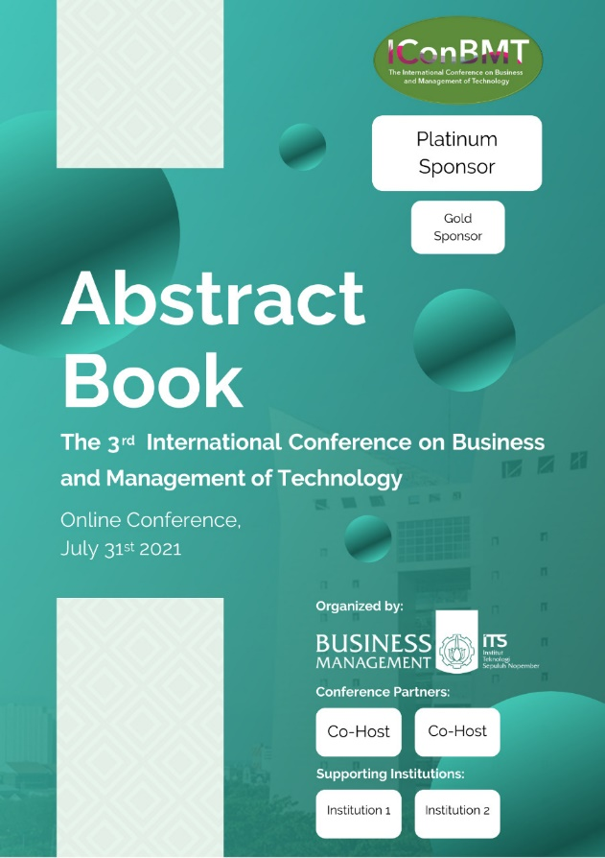
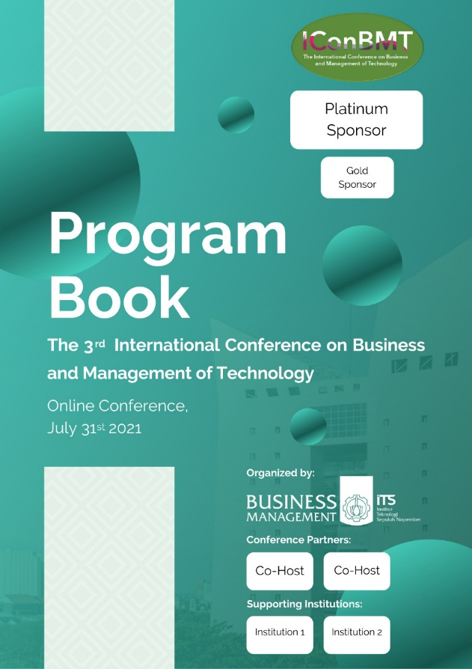
Abstract Book and Program Book Cover
Conference’s E-Certificate

Slide 12
Organized By
Conference Partners
Contact us
Geodita (+62-811-3377-703)
Rai ( +62-812-3086-7023)
Email: iconbmtmb@gmail.com
Website: https://www.its.ac.id/mb/conference/iconbmt2021/

