Slide 1
Build your career with UOU!
2025 WSU
Recruitment
Graduate School of Carbon-Neutral Technology Convergence
UNIVERSITY OF ULSAN
Graduate School of Next-Generation Secondary Battery Convergence

Slide 2


CONTENTS
WSU
Academic Program
How to Apply
Ulsan Metropolitan City
Study_UOU
Study_UNIST
Work
Scholarship
Specialized Graduate School of
Carbon-Neutral Technology Convergence
Specialized Graduate School of
Next-Generation Secondary Battery Convergence
Eligibility
Application Schedule
(2025 Autumn Intake)
Contact Information

Slide 3

1. WSU

Slide 4

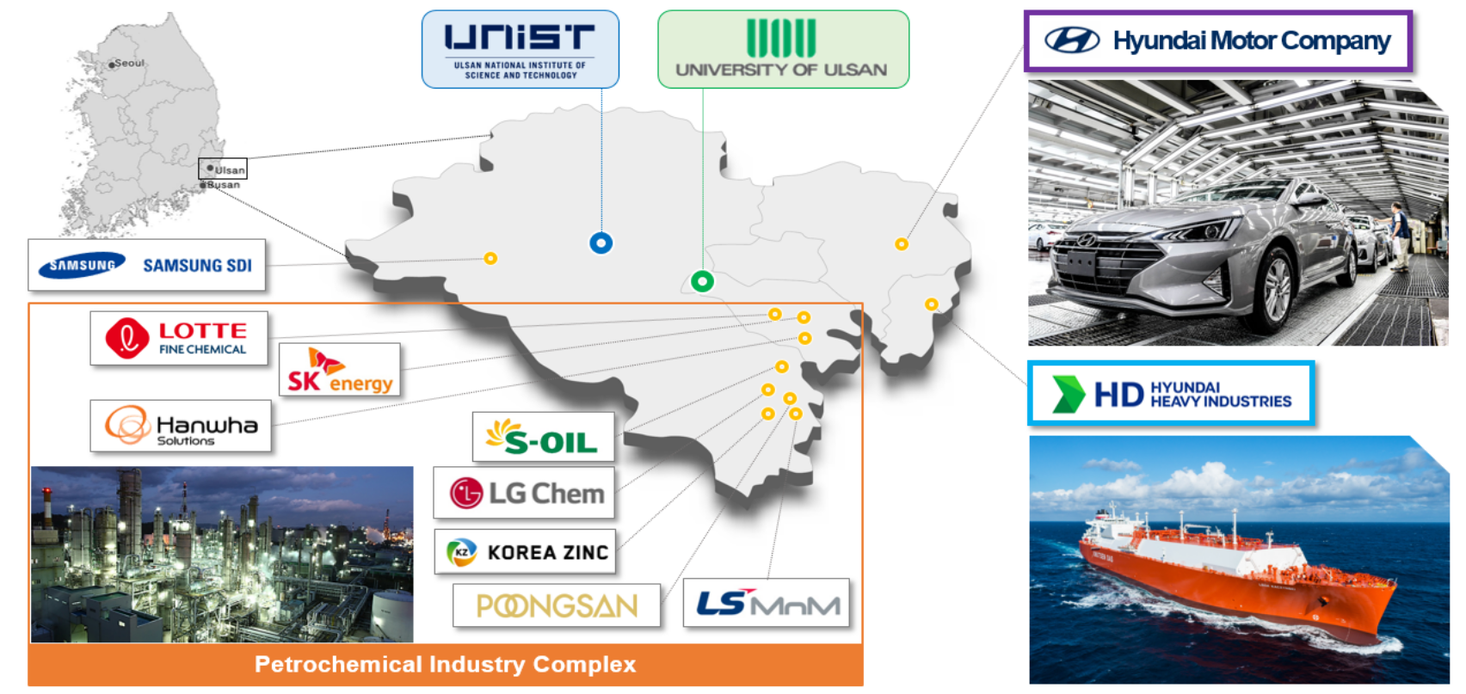
U
lsan Metropolitan City
UNIVERSITY OF ULSAN

Slide 5
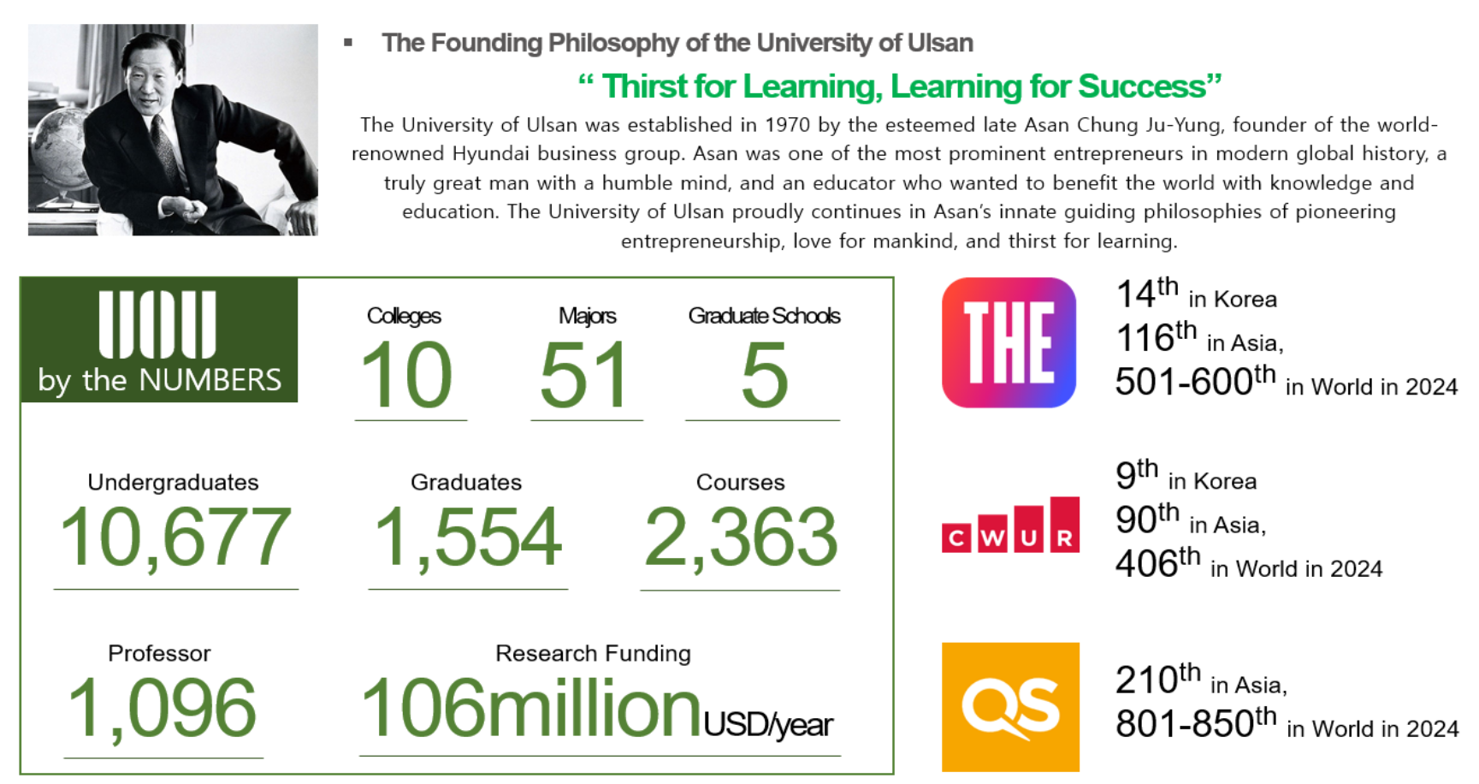
S
tudy_ UOU
UNIVERSITY OF ULSAN

Slide 6

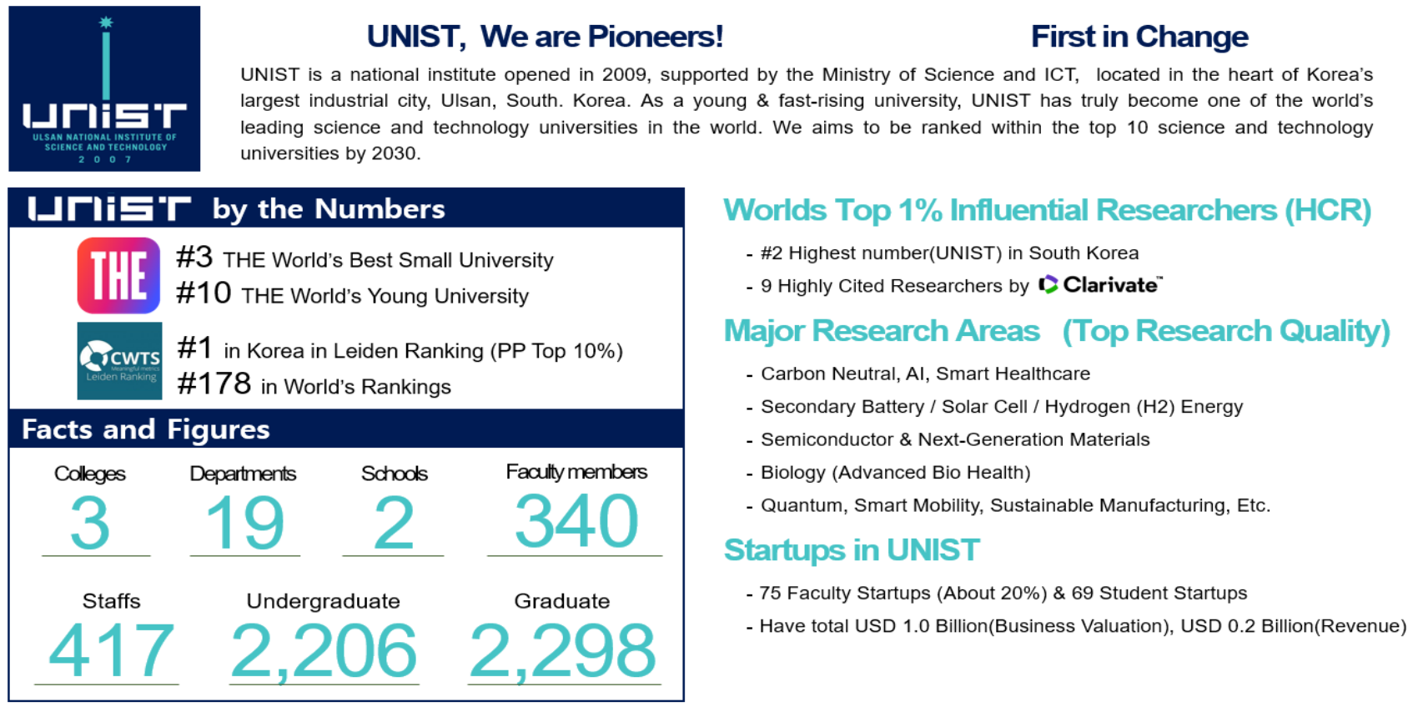
Study_UNIST(Ulsan National Institute of Science and Technology)
※Selected applicants will be invited to the UOU-UNIST Joint Degree Program based on specific criteria

Slide 7



W
ork
UNIVERSITY OF ULSAN
Employment at Korea Companies in the Home County
Vietnam
967 Companies (including Hyundai Motor Company and SK Innovation)
Indonesia
226 Companies (including LG Energy Solution and POSCO)
Europe
1,056 Companies (including Hyundai Motor Company, Samsung SDI)

Slide 8


Scholarship
UNIVERSITY OF ULSAN
Financial Support
Other benefits
Full Tuition Scholarship
Dormitory Accommodation
(Meals included)
Living Support Allowance
(KRW 800,000 per month)
Korean Language Education (100 hours)
Opportunity for paid Research Project
(around KRW 1 million if you have a good
research capability)
UOU - UNIST joint degree program
(Only those who meet specific criteria in the selection process will be assigned)
※Financial support will be offered for 2 years only.
※If you fail to finish your dissertation within 2 years, you are responsible for your study financially.
※The application fee, mandatory insurance for international students, and National Health Insurance must be paid individually.

Slide 9
2. Academic Program

Slide 10



Specialized Graduate School of
Carbon-Neutral Technology Convergence
UNIVERSITY OF ULSAN
Master's Degree
Curriculum
-Next-Generation Battery Materials
-Next-Generation Battery Manufacturing
- Performance Evaluation
- Non-Lithium Secondary Batteries
- Battery Recycling and Reuse
Faculty
Choi, Won Mook
Ga, Seongbin
Lee, Chan Hyun
Proffesor
Major
- Nanomaterials
- Carbon Materials
- Energy Storage Materials
Contact
(+82)052-259-1065
Email
wmchoi98@ulsan.ac.kr
Assistant Proffesor
Major
- Hydrogen Energy - CCUS
- Membrain Separation - Artificial Intelligence
- Particle and Process Simulation
Contact
(+82)052-259-2248
Email
sgasga@ulsan.ac.kr
Assistant Proffesor
Major
- Adsorbents
- Separation Processes
- Hydrogen Production
Contact
(+82)052-259-2250
Email
chhylee@ulsan.ac.kr

Slide 11

Specialized Graduate School of
Next-Generation Secondary Battery Convergence
UNIVERSITY OF ULSAN
Master's Degree
Curriculum
-Next-Generation Battery Materials
-Next-Generation Battery Manufacturing
- Performance Evaluation
- Non-Lithium Secondary Batteries
- Battery Recycling and Reuse
Faculty
OH, Eun-Suok
Ryu, Kwang-Sun
Kim, Tae-Hee
Proffesor
Major
- Lithium Ion Battery
- Applied Mechanics
Contact
(+82)052-259-2783
Email
esoh1@ulsan.ac.kr
Proffesor
Major
- Energy material / device
- Nanochemistry
- Conducting polymer
Contact
(+82)052-723-8003
Email
ryuks@ulsan.ac.kr
Assistant Proffesor
Major
- Secondary Batteries
- Electrochemistry
- Energy Storage
Contact
(+82)052-259-2243
Email
kimtaehee@ulsan.ac.kr

Slide 12
3. How to Apply

Slide 13
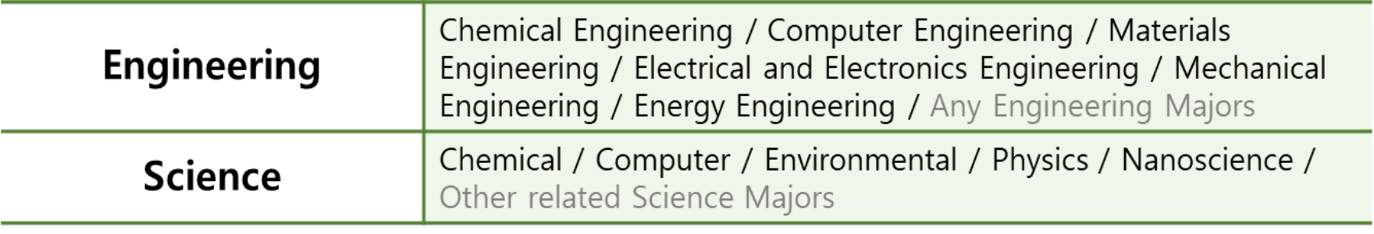
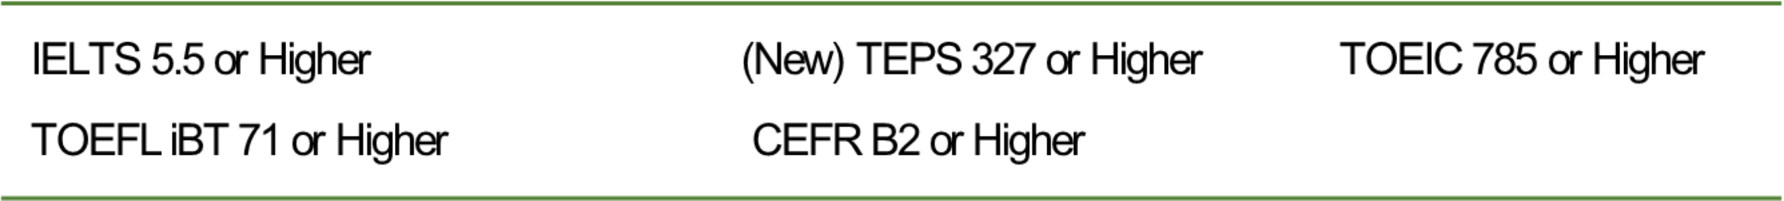
Eligibility
UNIVERSITY OF ULSAN
Undergraduate Major of Prospective Students
Language Requirement

Slide 14
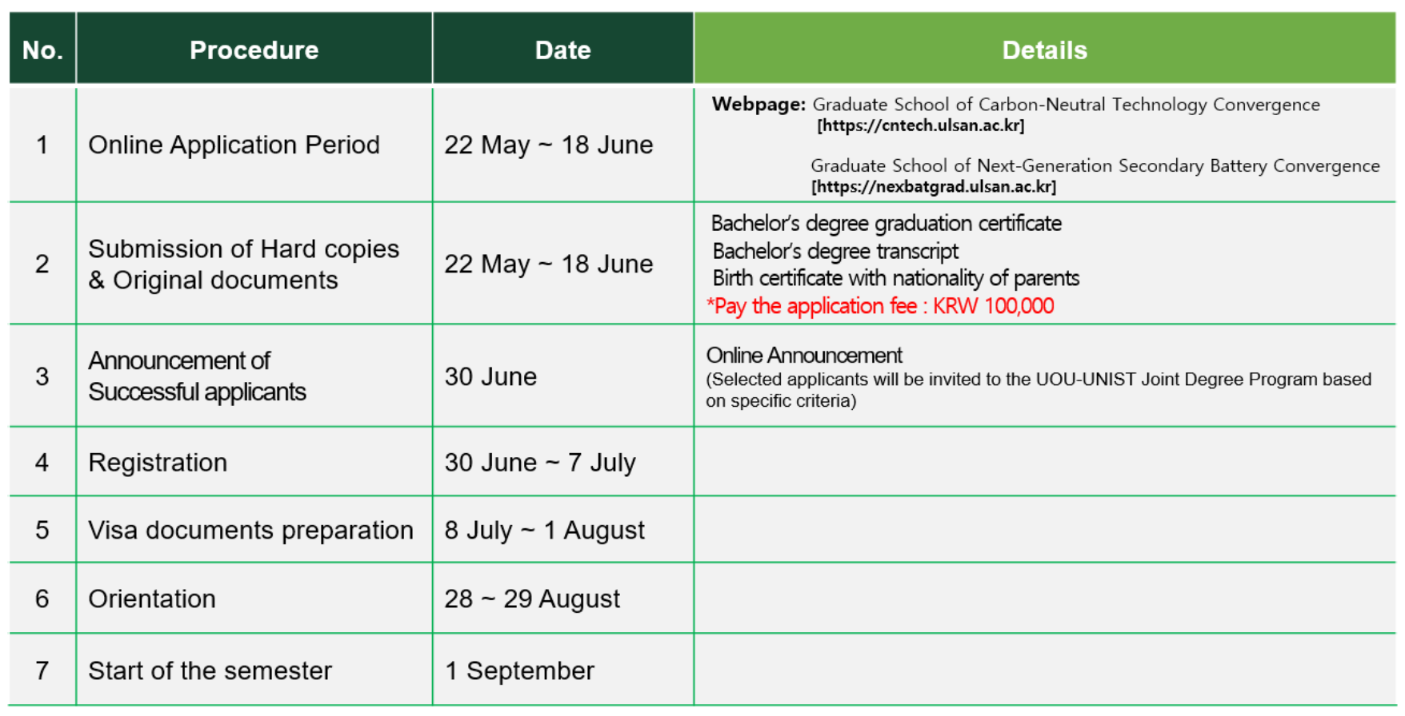
Application Schedule (2025 Autumn Intake)
UNIVERSITY OF ULSAN

Slide 15
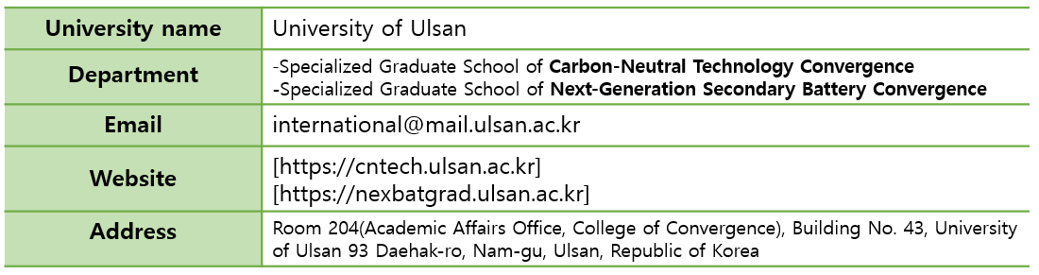
Contact Information
UNIVERSITY OF ULSAN

Slide 16

Build your career with
UOU

