Slide 1

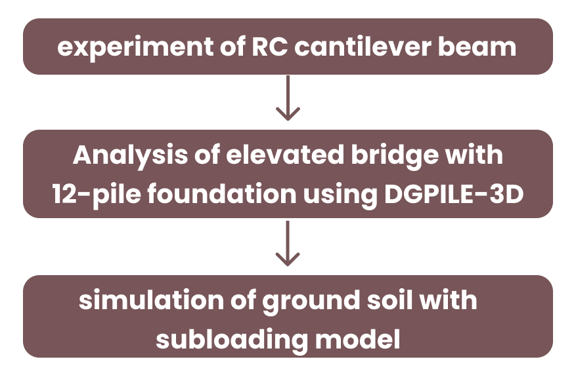
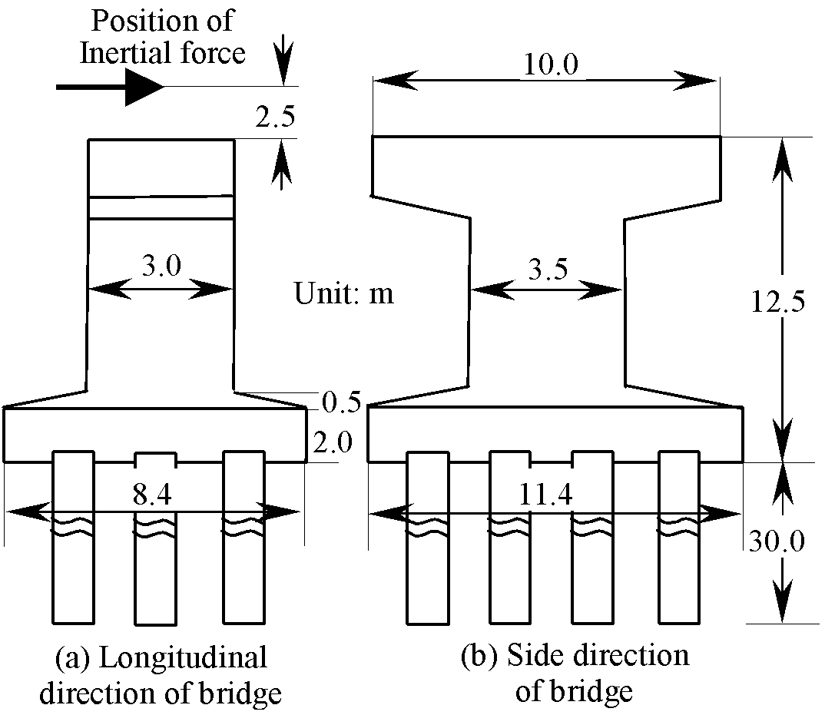
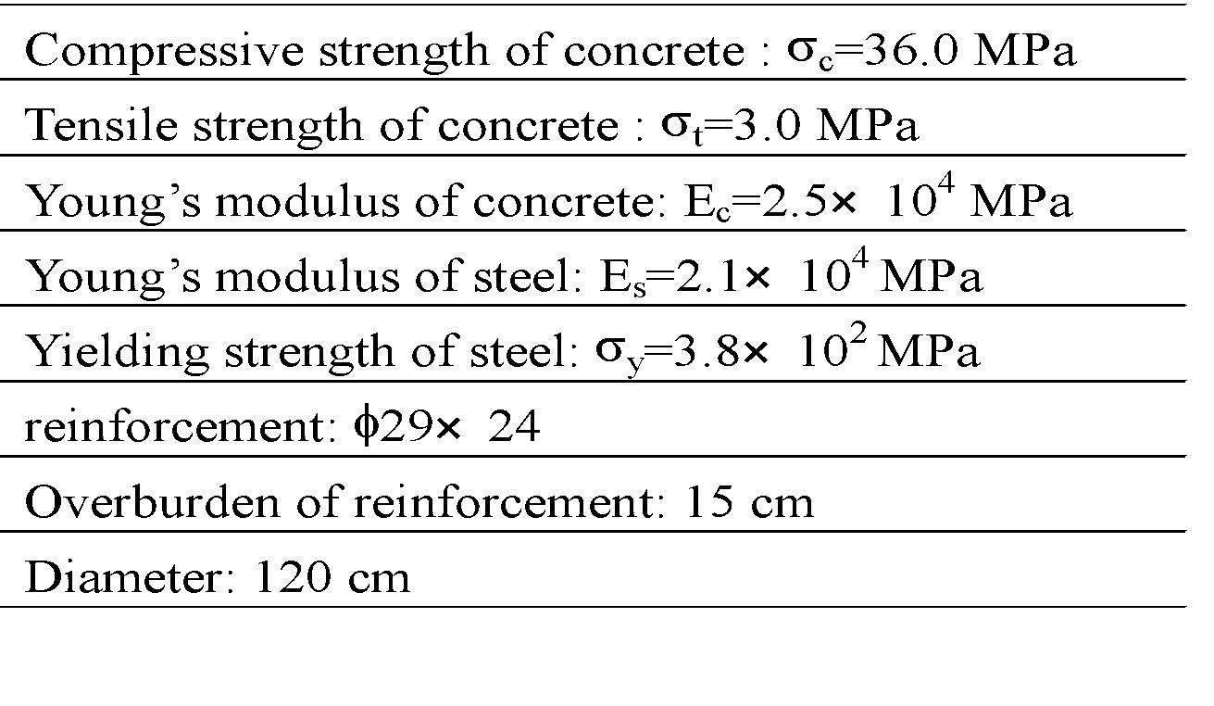
NUMERICAL PREDICTION OF THE DYNAMIC BEHAVIORS OF AN RC GROUP-PILE FOUNDATION
Fen Cheng
Masato Kitamura
Kyoto University
Kyoto University
11
1
RESEARCH BACKGROUND
11
2
METHODS
In a major earthquake, the dynamic behavior of group-pile foundation is not only related to the inertial force coming from the superstructures but also the deformation of the surrounding ground or known as the kinematic moments. It is recommended, therefore, that a full system, which consists of superstructures, foundation and ground, be considered in the dynamic analysis because of the merit that relatively few assumptions are adopted. The most important thing in the dynamic analysis, however, is that the individual nonlinear behavior of soils and piles should be properly evaluated. In this paper, a new beam theory is proposed for a reinforced concrete material (RC material). The theory is based on a weak form in which the axial-force dependency in the nonlinear moment-curvature relation is considered.This purpose of this paper is to provide an accurate numerical way of evaluating the dynamic behavior of a pile foundation during and earthquake
Its validity is verified by experimental results of an RC cantilever beam. Then, an elevated bridge with a 12-pile foundation is analyzed using a three-dimensional elastoplastic finite element analysis (DGPILE-3D). The piles are cast-in-place reinforced concrete pile and have a diameter of 1.2 m. Meanwhile, the ground soil is simulated with tij subloading model in which the concepts of kinematic hardening and subloading are adopted.
11
3
RESULTS
The new model can well simulate the axial-force dependency of RC materials under monotonic and cyclic loadings. Its validity is verified by experimental results with a very high accuracy. By introducing an axial-force dependent nonlinear model for the M-iP relation of RC material, the difference among the distribution in bending moments of front, back and middle piles in a group-pile foundation subjected to seismic loading can be well simulated. In the present analyses, without using a suitable axial-force dependent model for piles, such as the AFD model, it is impossible to simulate well the difference aforementioned.
A different constitutive model of soil may give a quite different prediction of the deformation and the acceleration of the ground, resulting in a different response of the superstructure. The acceleration transferred from the ground to upperstructure is underestimated by the D-P model due to the overestimated absorption of earthquake energy by the deformation of the ground.
Due to the difference of the deformation predicted by different constitutive models, the distributions of the moment in the piles are quite different. The time history of the moment is also different if the soil is described with different models.
A large moment occurs not only at the head of piles, usually caused by the inertial force from the upper structure, but also within the ground. Therefore, it is worth emphasizing that the influence of the deformation of a ground on the piles must be considered carefully.
Geometry of Elevated Highway Bridge
Parameters of cantilever 1
Fen Cheng
Fen Cheng
+61 7865 31289
fen.cheng@gmail.com
+61 7865 31289
fen.cheng@gmail.com

Slide 2
POSTER TITLE (left aligned)
Name
Name
Name
Affiliation
Affiliation
Affiliation
11
1
RESEARCH BACKGROUND
11
2
METHODS
The size of this box is adjustable according to your need
The size of this box is adjustable according to your need
11
3
RESULTS
The size of this box is adjustable according to your need
PICTURE/GRAPHS
Name, email, phone number, etc

