Slide 1
IKI Small Grants

Slide 2
How to draw up
a budget for your IKI Small Grants proposal

Slide 3
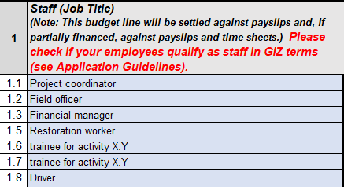
I. Calculation of staff costs
One person per budget line
No names or qualifications (e.g. Dr.) to be stated
Description of position/role (and tasks) in the project

Slide 4
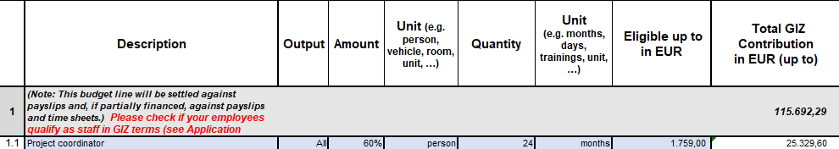
I. Calculation of staff costs
To minimize administrative effort it is recommended staff members work on the ISG project with a larger percentage
Associated output to be stated
Percentage reflects the working time allocated to the project based on a full-time employee
Number of months need to match project duration
Full-time gross incl. employer’s contribution salary to be entered

Slide 5
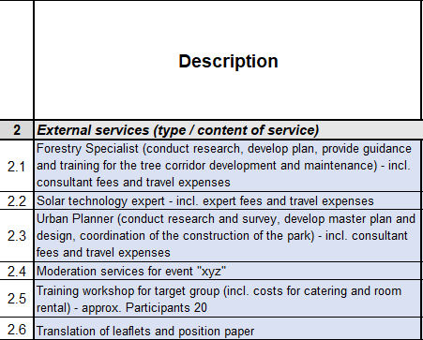
II. Calculation of external services
Important to describe actual service
what specific expenditures are included
and
Event costs:
Any service commissioned for an event such as venue rent, resource person(s) andrented equipment as well as hired catering should be included under 2. External services also stating the expected number of participants

Slide 6
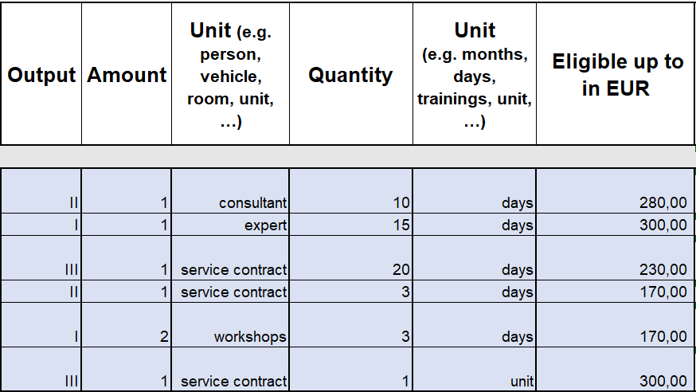
II. Calculation of external services
Monetary calculation should present details of how funds (e.g. breakdown in hourly/daily rate) are going to be spent

Slide 7
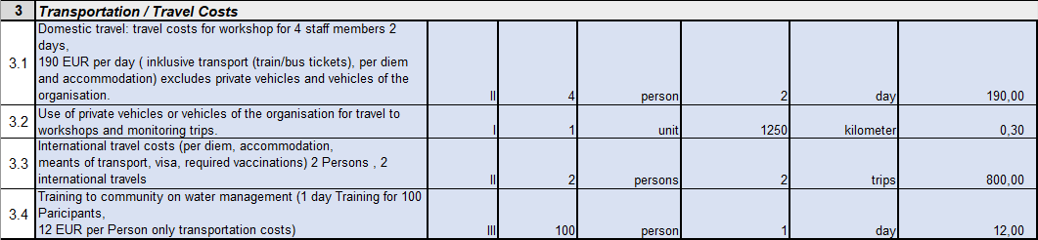
III. Calculation of transportation / travel costs
Note: Transportation/ Travel costs for external services should be recorded in the Budget line „External Services“
Own staff/ employees (cost per day/) based on an averageperson amount per trip and number of trips to be calculated
Travel costs for the use of private vehicles or vehicles of the organisation (distance calculation of max. EUR 0,30 per km instead of e.g. fuel costs).
Transportation costs for participants of trainings or workshops should be enter in this budget category

Slide 8
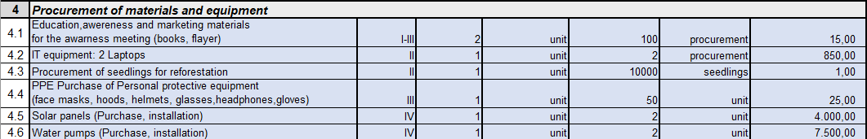
IV. Calculation of procurement of materials and equipment
Various examples of different kind of items to be procured for project implementation
Breakdown calculation for price per item for reconciliation purposes

Slide 9
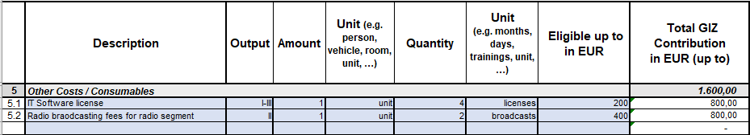
V. Calculation of other costs / consumables
This category (5) is for all the costs that do not match the descriptions of the other categories.

Slide 10
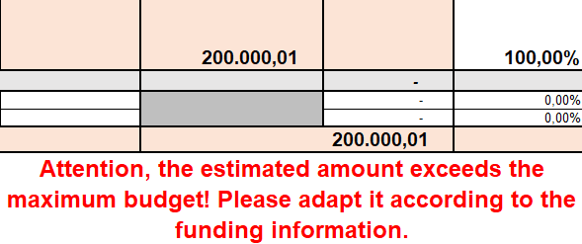
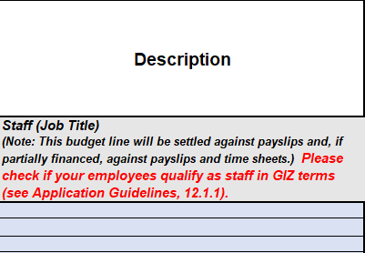
VII. General note
Make sure to remain within the correct funding volume
Description column should:
Not include unclear expressions such as “etc.”or “…”
Cleary describe what expenditures are purchased and not what kind of activity is implemented
Use terms for items and not specific product names

Slide 11
IKI Small Grants
Deutsche Gesellschaft für Internationale
Zusammenarbeit (GIZ) GmbH
Potsdamer Platz 10
10785 Berlin
iki-small-grants (at) giz.de

