Slide 1
Human Centered Design (HuCeD) Lab Profile
Departemen Desain Produk
Fakultas Desain Kreatif dan Bisnis Digital (F- Creabiz)
Institut Teknologi Sepuluh Nopember - Surabaya
2023

Slide 2
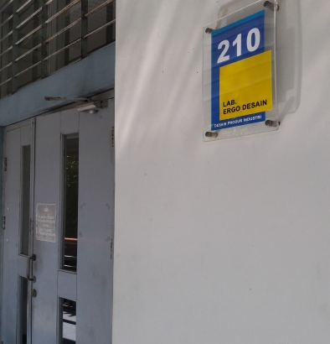
About HuCeD
Human Centred Design primary areas of emphasis include user behavior, user experience, cultural-based design, and interdisciplinary collaboration, all aimed at enhancing the overall quality of life.
The key focuses are :
User Behavior: We analyze and understand user behaviors to inform the design process. This includes studying how individuals interact with products and environments to create solutions that seamlessly integrate into their lives.
User Experience: The goal is to craft meaningful and positive experiences for users. We design products that not only meet functional requirements but also evoke emotional responses and satisfaction.
Cultural-Based Design: We recognize the importance of cultural influences in design. Our team actively incorporates diverse cultural perspectives into the design process to create products that resonate with a wide range of audiences and celebrate cultural richness.
Interdisciplinary Design Collaboration: The group fosters a dynamic environment where designers, researchers, and experts from various fields come together to share insights and work collaboratively on projects, ensuring a holistic and comprehensive approach.

Slide 3
Laboratory Activities
Research, community service and student practical work. The research inlude:
Physical research, research which is focused on human physical aspects: antropometri, work load, psychophysical and biomechanics.
Cognitive research: research which is focused on human cognitive aspects: human-equipment interaction, product standard, sport science and participatory design.
Environmental research: research which is focused on environment aspects and productivity: visual, noise, vibration, air quality and temperasture also airflow pattern.

Slide 4
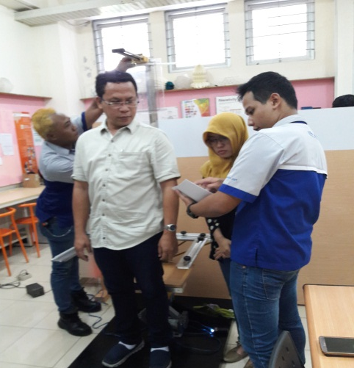
Facilities
Physical research: antropometri chair, human modeling, tandem bike prototype, Ergofellow software, 3d scanning
Cognitive research: display model, push button model, Eye Tracker, EEG, realeye.io online eyetracking
Environmental research: numeric simulation, luxmeter, noise level meter, temperature meter, tachometer, velocity meter.

Slide 5
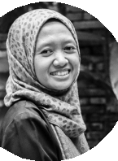
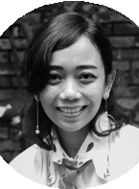
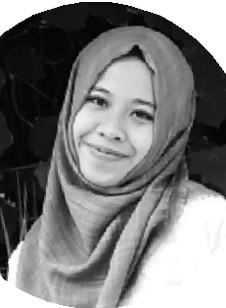
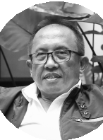
Member of HuCeD
Left to Right:
Ellya Zulaikha, PhD – Hertina Susandari, M.T – Irna Arlianti, M.Ds –
Prof. Bambang Iskandriawan

Slide 6
Current research objects

Slide 7
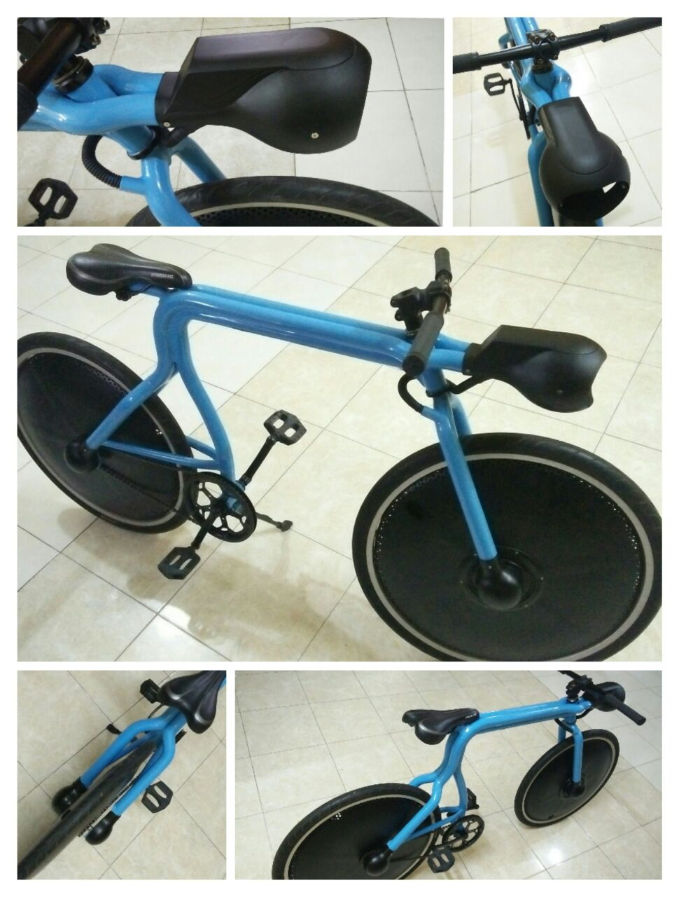
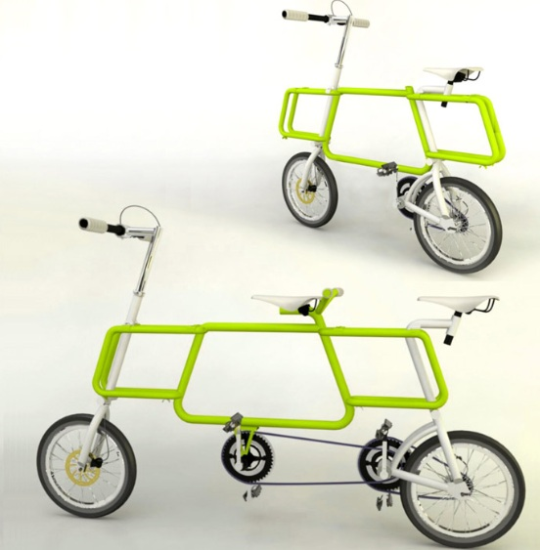
Bike design based on User Behaviour
Air Purifiying Bike
Commuter Bike
Trandem (Transform to Tandem Bike)

Slide 8
Jewelry
Investigating the intersection of culture, personal expression, and craftsmanship to design jewelry that goes beyond ornamentation, telling stories and connecting individuals to their heritage.
Collaboration with Sheffield Hallam Univ and Just Trade UK

Slide 9
Experiential Dining Ware:
Exploring innovative designs that enhance the dining experience, considering both functionality and aesthetic appeal to create memorable moments around shared meals.
Traditional Stool:
Examining the traditional stool as a design object, with a focus on cultural significance, ergonomic considerations, and modern reinterpretations that maintain its authenticity while meeting contemporary needs

Slide 10
Collaboration
Thrill Bike
Bank Indonesia
Sheffield Hallam University
University Teknikal Melaka

