Slide 1
Human Centered Design
(HUCED)

Slide 2
Deskripsi Laboratorium
Bidang riset yang dilakukan di Lab Human Centered Design adalah:
1.Physical Research, yang merupakan riset yang berfokus pada aspek fisik dari manusia. Physical Research dapat dibagi menjadi 3, yaitu: penelitian mengenai antropometri dalam pengembangan database standar dimensi manusia (data statis), penelitian mengenai psychophysical dalam pengembangan kerangka penelitian mental workload, dan penelitian mengenai biomekanikal dalam pengembangan database standar untuk gerakan manusia (data dinamis). Beberapa peralatan dan software yang menunjang riset ini diantaranya: Anthroscan 3D Body Scanner, Jack Simulation and Human Modeling, Motion Capture, Hand Dynamometer, Fitmate dan VO2 Max.
2.Cognitive Research, yang merupakan riset yang berfokus pada aspek kognitif manusia. Cognitive Research dapat dibagi menjadi 3, yaitu: penelitian mengenai Human-Computer Interaction, pengembangan standar kemasan dan tata letak produk, dan sport science. Beberapa peralatan dan software yang menunjang riset ini adalah: Eye-tracker, Cogtools, dan Design Tools.
3.Environmental Research, yang merupakan riset yang berfokus pada penelitian mengenai aspek lingkungan yang mempengaruhi produktivitas, yaitu: visual, kebisingan, vibrasi, kualitas udara, dan temperatur. Riset ini bertujuan untuk memetakan kondisi lingkungan dimana manusia beraktivitas, mengevaluasi dan mendesain standar lingkungan pada industri, mengevaluasi efek dari faktor lingkungan pada produktivitas pekerja, dan mendesain guidelines untuk penjaminan keselamatan manusia terhadap faktor lingkungan. Beberapa peralatan dan software yang menunjang riset ini adalah: Acoustic and Hearing System, Climate Room, Luxmeter, Haz Dust, Sound Level Meter, dan Vibration Meter.
SDGs terkait Lab Human Centered Design di antaranya adalah: SDG 3 (Good health and well-being), SDG 9 (Industry, innovation and infrastructure), SDG 11 (Sustainable cities and communities, SDG 13 (Climate action)

Slide 3
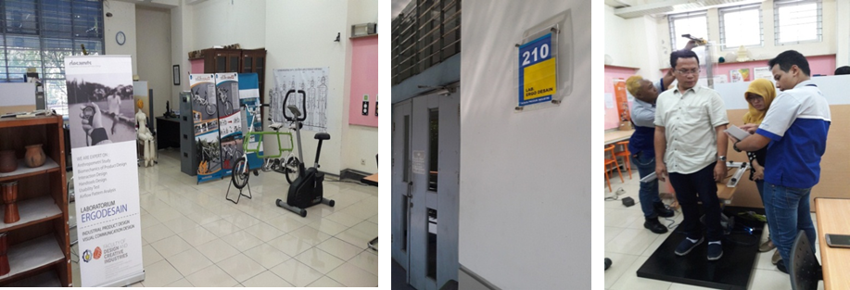
Tampilkan foto gedung atau ruangan lab, dari dalam maupun luar gedung (jika memungkinkan).

Slide 4
List riset dan pengabdian
Tahun | Judul | Peneliti | Skema | Dana
2016 | Rancang Bangun Air Purifier Bike untuk Sarana Transportasi Jarak Dekat Komunitas Sosial dan Sebagai Inisiatif untuk Mengurangi Tingkat Polusi Udara di Perkotaan | Dr. Ir. Bambang Iskandriawan, M. Eng. | Insentif Riset Sistem Inovasi Nasional | 215.000.000
2017 | Telaah Pendekatan Heuristik dalam Metode Penelitian Desain untuk Meningkatkan Kualitas Tugas Akhir Mahasiswa | Ellya Zulaikha, S.T., M.Sn., Ph.D | Dana Departemen | 20.000.000
2017 | Desain Orthosis untuk Penderita Cerebral Palsy Spastik dengan Metode Rapid Prototyping | Hertina Susandari,S.T., M.T. | Penelitian Dasar Internal Perguruan Tinggi - Dalam Negeri | 100.000.000
2017 | Desain Penggoreng (Air fryer) Kerupuk Tanpa Minyak, Tanpa Pasir dan Tanpa Listrik untuk Rumah Tangga Menengah | Hertina Susandari,S.T., M.T. | Penelitian Dasar Internal Perguruan Tinggi - Dalam Negeri | 50.000.000

Slide 5
Tahun | Judul | Peneliti | Skema | Dana
2017 | Perumusan Kebijakan Pengembangan Sistem Terintegrasi Aplikasi Smart Eco Campus untuk Meningkatkan Pengetahuan Warga ITS tentang Program ITS Smart Eco Campus | Hertina Susandari,S.T., M.T. | Penelitian Dasar Internal Perguruan Tinggi - Dalam Negeri | 25.000.000
2019 | Pengolahan Plastik Daur Ulang sebagai Material Baru Furniture | Ellya Zulaikha, S.T., M.Sn., Ph.D | Dana Departemen | 20.000.000
2018 | Studi Penggunaan Bahan Anti Semut Alami untuk Dinnerware | Ellya Zulaikha, S.T., M.Sn., Ph.D | Dana Departemen | 20.000.000
2018 | Pengembangan Air Purifier Bike untuk Menunjang Upaya Penurunan Tingkat Polusi Udara Kota | Dr. Ir. Bambang Iskandriawan, M. Eng. | Program Pengembangan Teknologi Industri I | 678.900.000
2018 | Usaha Penghematan Konsumsi Energi Listrik Sistem Pengkondisian Udara pada Gedung Apartemen melalui Studi Orientasi, Elevasi dan Material Bangunan | Dr. Ir. Bambang Iskandriawan, M. Eng. | Penelitian Unggulan Dana ITS | 397.409.000

Slide 6
Tahun | Judul | Peneliti | Skema | Dana
2019 | Pengolahan Plastik Daur Ulang Sebagai Material Baru Furniture | Ellya Zulaikha, S.T., M.Sn., Ph.D | Dana Departemen | 20.000.000
2019 | Penggunaan Balance Scorecard dalam Penyusunan Perencanaan Pengadaan Belanja Modal Laboratorium untuk Peningkatan Efisiensi Anggaran di Lingkungan ITS | Hertina Susandari, S.T., M.T.c | Penelitian Dasar Internal Perguruan Tinggi - Dalam Negeri | 10.000.000
2019 - 2021 | Desain Model Pariwisata Bahari Berbasis Masyarakat | Hertina Susandari, S.T., M.T. | KRU - PT Dikti | 300.000.000
2020 | Desain Portable Commuter Bike yang Sesuai dengan Karakteristik Moda Transportasi Kota | Dr. Ir. Bambang Iskandriawan, M. Eng. | Penelitian Terapan Kompetitif Nasional Ristekdikti/Ristekbrin | 113.600.000

Slide 7
Tahun | Judul | Peneliti | Skema | Dana
2020 | Desain Interior dan Human Factors iCar ITS | Dr. Ir. Bambang Iskandriawan, M. Eng. | Penelitian Unggulan Dana ITS | 110.000.000
2020 | Telaah Efektifitas Metode Pengalaman Pengguna (Ux Research) Dalam Pengembangan Desain Produk Perhiasan | Ellya Zulaikha, S.T., M.Sn., Ph.D | Dana Departemen | 20.000.000
2021 | Desain Smart Detachable Air Purifier untuk Penggunaan di Mobil dan di Rumah sebagai Upaya Peningkatan TKDN Produk | Dr. Ir. Bambang Iskandriawan, M. Eng. | Penelitian Kolaborasi Pusat ITS | 200.000.000
2021 | Desain Enclosure dan User Interface untuk Smart Detachable Air Purifier untuk Penggunaan di Mobil dan di Rumah sebagai Upaya Peningkatan TKDN | Dr. Ir. Bambang Iskandriawan, M. Eng. | Penelitian Kolaborasi Pusat ITS | 100.000.000
2021 | Pengembangan Prototype dan Uji Klinik Smart Laryngoscope | Ellya Zulaikha, S.T., M.Sn., Ph.D | Penelitian Kolaborasi Pusat ITS (dengan Lab SDM) | 50.000.000

Slide 8
Tahun | Judul | Peneliti | Skema | Dana
2021 | Pengembangan Desain Innovative Dinnerware untuk Menunjang Gastronomy Tourism | Ellya Zulaikha, S.T., M.Sn., Ph.D | Kemitraan Sumber Dana ITS | 50.000.000
2021 | Desain Smart Office Desk sebagai Sarana Work Life Balance | Irna Arlianti, S.T., M.Ds. | Dana Departemen | 20.000.000

Slide 9
List kerjasama internasional
Tahun | Nama Program | Dosen | Jenis Program | Mitra
2019 | Super Lecture Series | Ellya Zulaikha, S.T., M.Sn., Ph.D ; Heat Read ; Andy stanton | Seminar / conference | Sheffield Hallam University
2019 | Design Thinking in Jewerly Design | Ellya Zulaikha, S.T., M.Sn., Ph.D ; Maria Hanson ; Laura Cave | Research visit | Sheffield Hallam University
2020 | Keep Online Design Thinking Alive: a Case Study in Indonesia | Ellya Zulaikha, S.T., M.Sn., Ph.D ; Dr. Eunice Sari | Publikasi bersama | UX Indonesia ; Customer Experience Insight Pty Ltd (Australia)

Slide 10
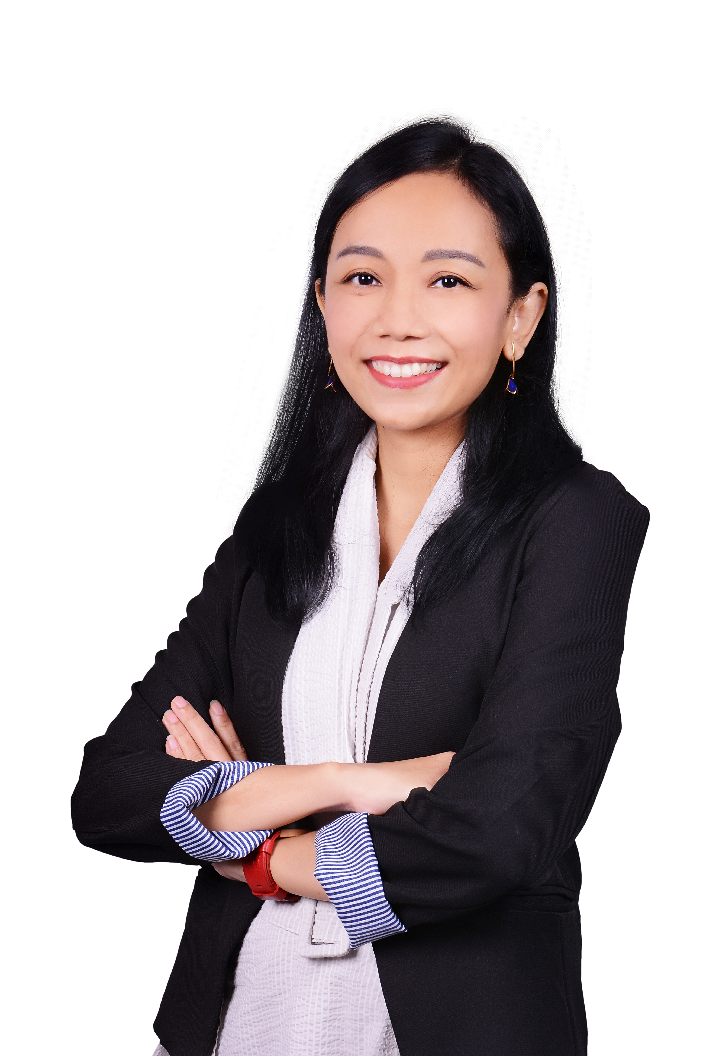
Anggota Laboratorium
Ketua Laboratorium
Hertina Susandari, S.T., M.T.

Slide 11
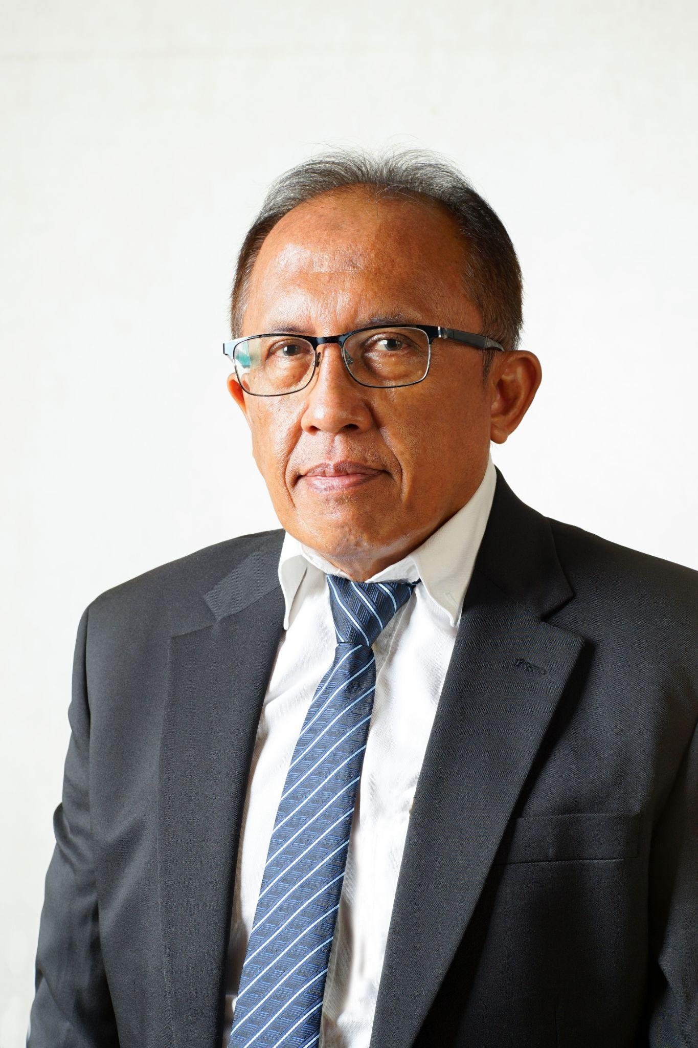
Anggota Laboratorium
Anggota Laboratorium
Dr. Ir. Bambang Iskandriawan, M. Eng.

Slide 12
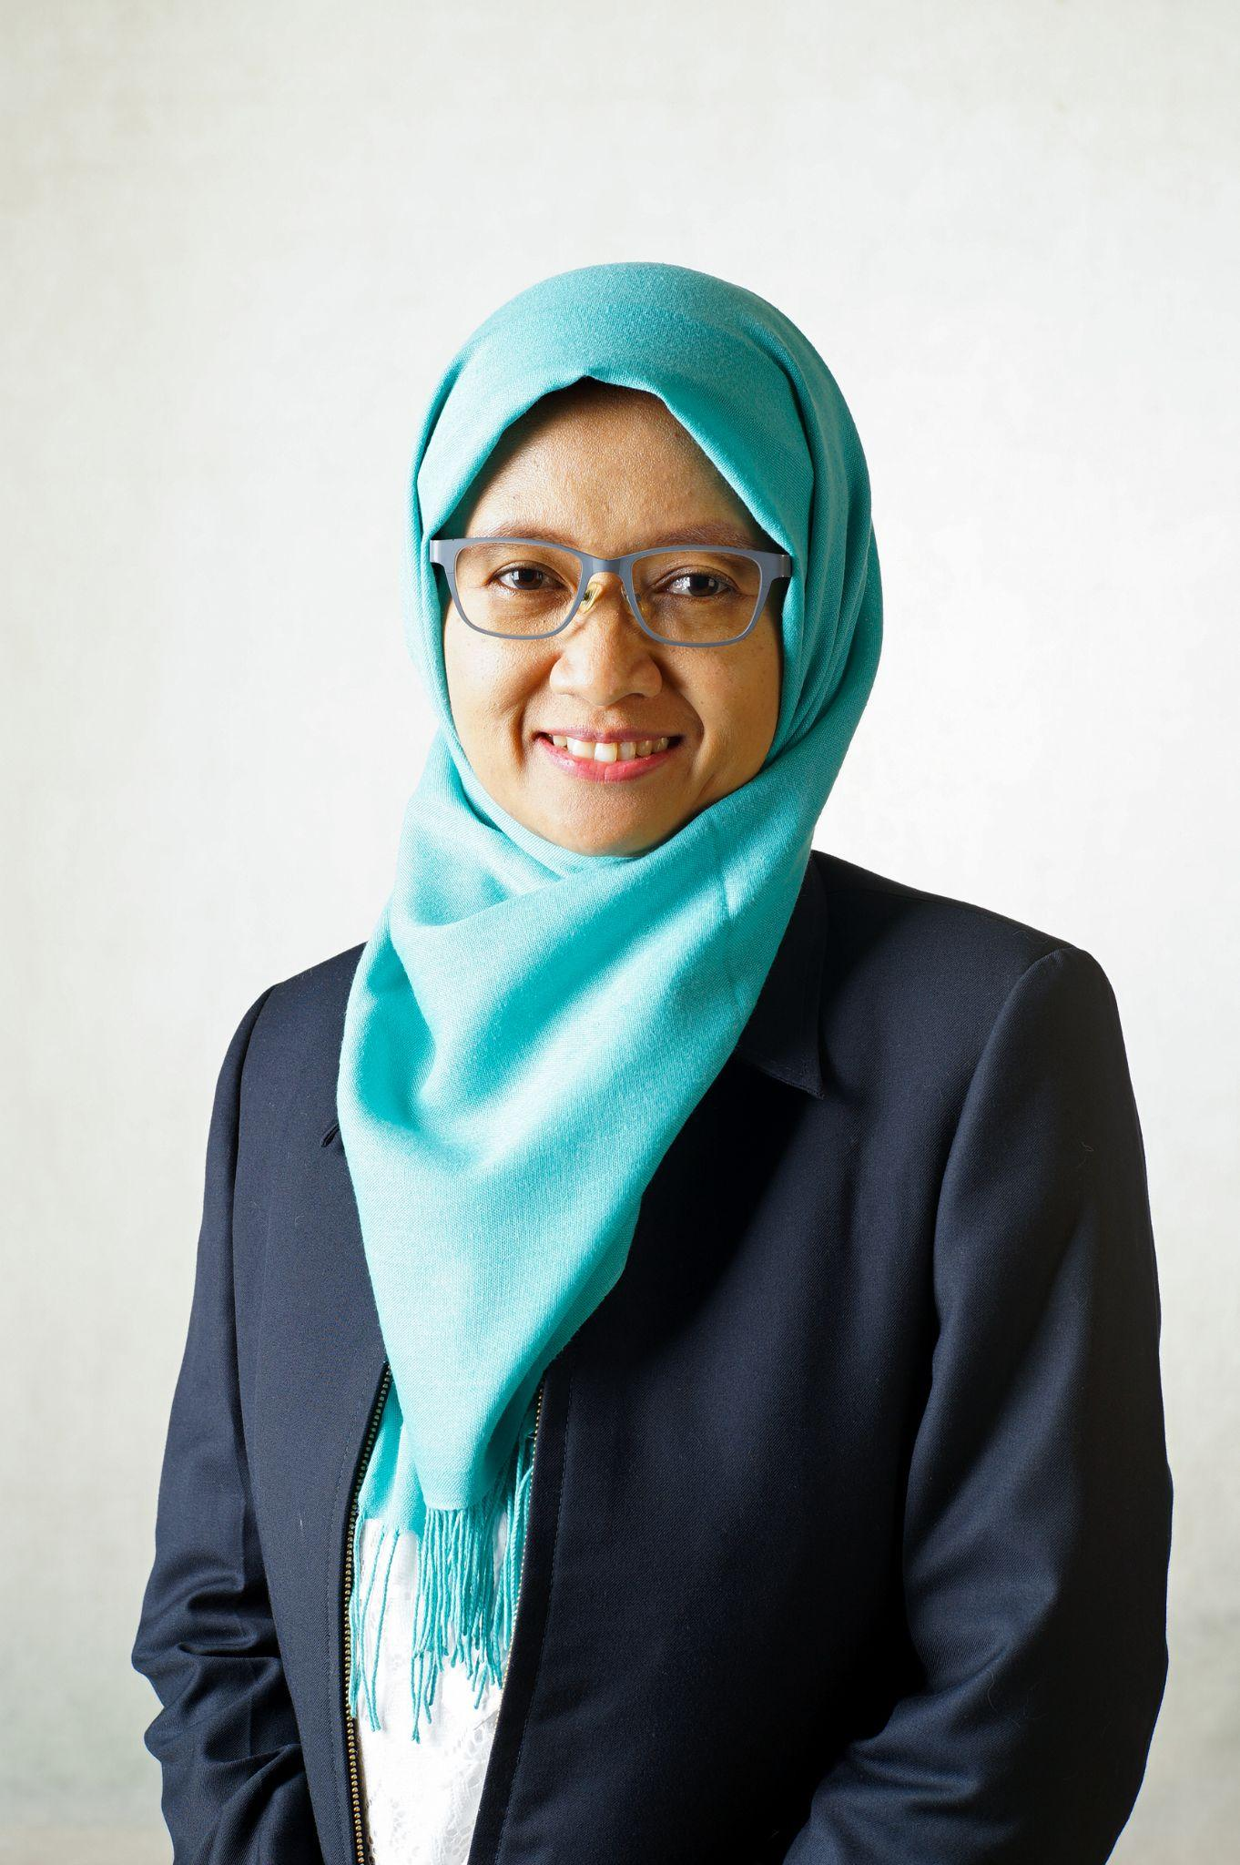
Anggota Laboratorium
Anggota Laboratorium
Ellya Zulaikha, S.T., M.Sn., Ph.D

Slide 13
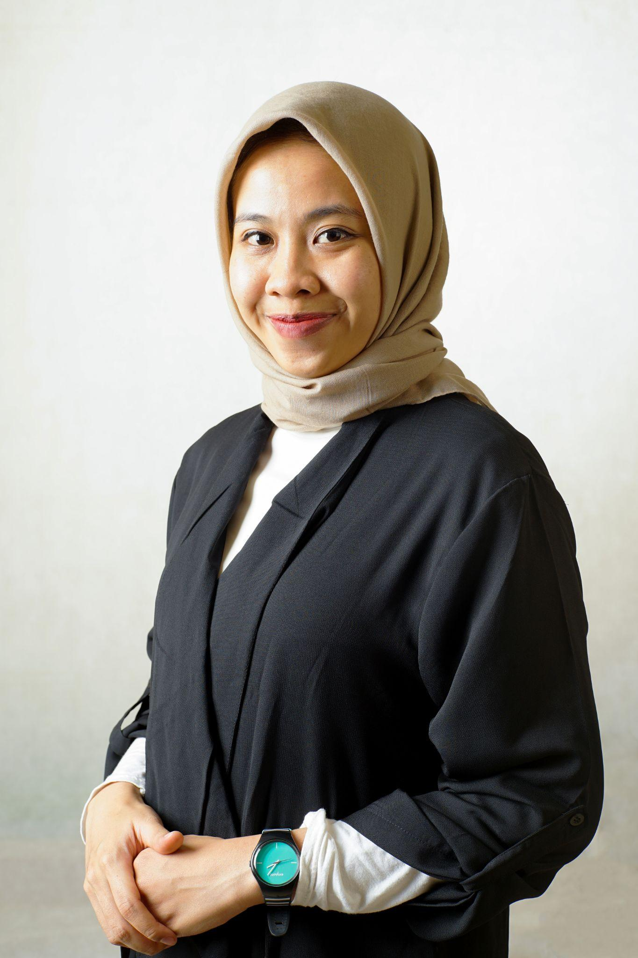
Anggota Laboratorium
Anggota Laboratorium
Irna Arlianti, S.T., M.Ds.

Slide 14
Roadmap Penelitian
Desain
Development
Komersialisasi
Tandem frame coneector (Lynx)
Sliding tandem bike 3 varian
Air purifier bike
2020
2021
2022
2023
2024
Portable commuter bike: manual & elektrik
Prototype & pengembangan desain sepeda hi-CUB
Development
Development, sertifikasi
[Desain Transportasi - Sepeda]

Slide 15
Roadmap Penelitian
Prototipe
Hilirisasi produk
Sertifikasi & Komersialisasi
Street furniture
Mass product
Custom
2020
2021
2022
2023
2024
Prototipe
Hilirisasi produk
[Desain Furnitur]

Slide 16
Roadmap Penelitian
Traveller’s dinnerware
Special dinnerware
Innovative experiental dinnerware
Styling
Smart system
2020
2021
2022
2023
2024
Innovative material
Baby & kids dinnerware
Gastronomic tourism
Temporary event
[Eksplorasi material baru - skala industri, UMKM, home industry]

Slide 17
Aktivitas Laboratorium
Aktifitas layanan berdasarkan bidang riset :
1. Physical research: antropometri chair, human modeling, tandem bike prototype
2. Cognitive research: display model, push button model
3. Environmental research: numeric simulation, luxmeter, noise level meter, temperature meter, tachometer, velocity meter.
Perkuliahan (Susunan RMK) :
Buat daftar aktifitas laboratorium berdasar fokus lab. Aktifitas bisa berupa pelayanan (menerima pesanan desain/model/pengolahan data/dsb), perkuliahan (susunan RMK, kuliah tamu ke Univ/lembaga luar/dsb), dan aktifitas lain yang menunjang kegiatan laboratorium
MK Wajib
Desain Produk 3 Ergonomi Kreativitas Riset Desain Sistem Desain Dasar Desain 3
MK Pilihan
Desain Furnitur 1 Desain Furnitur 2

Slide 18
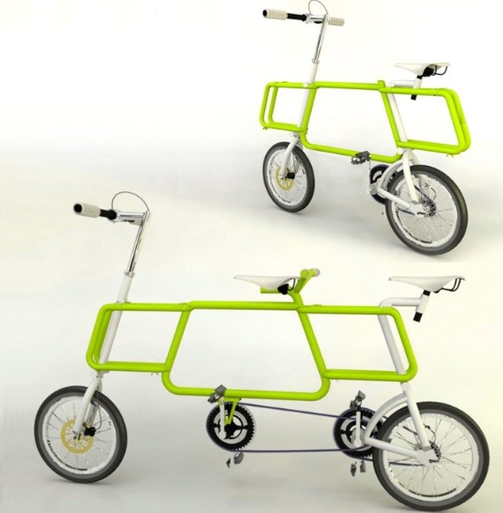
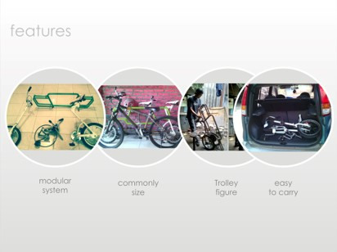
1- Rancang Bangun Sepeda Tandem Serbaguna untuk Penghuni Gedung Apartemen di Surabaya dalam Rangka Peningkatan Kualitas Lingkungan di Perkotaan (2015)
Bidang penelitian : Desain Transportasi (geometri, rekayasa desain)
Tahun berlangsung :
Sumber & besaran dana : Penelitian Unggulan Dana ITS
Deskripsi penelitian :
Vertical housing is recently popular in urban areas since the availability of land is very limited. A strong preference for living in the city is mainly due to the home to work travel that is relatively close for those who work in the city. While residing in the vertical housing (i.e. apartment) can be an advantage, several accommodation facilities are often provided at their minimum standards. As such, a special design of bicycle for apartment residents may an effective solution. Multi-function bike, ridden either by one or two riders and its aesthetic part of interior element can be an attractive offer. Identification of marketing objectives and observation of comparable products were a crucial step in the initial process of tandem bike design. The use of bicycle in urban areas can overcome a number of motorized vehicles operating wherever the using of them may create issues such as traffic jam and air pollution. This study aims to adjust the tandem bike which can be produced commercially for the apartment residents. Stated in the research problems, the design process was successfully fulfilled. Fabrication and product testing were positively completed. A concise and comfortable bike to carry from the lobby to the apartment unit, or vice versa, was successfully created

Slide 19
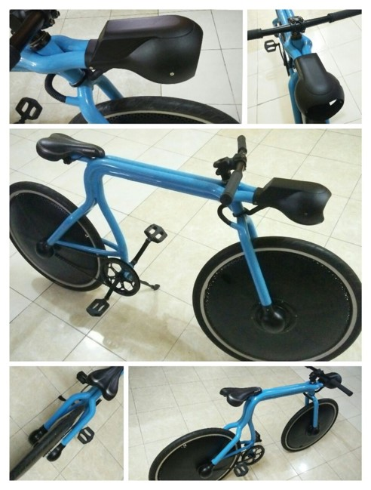
2- Pengembangan Air Purifier Bike untuk Menunjang Upaya Penurunan Tingkat Polusi Udara Kota (2018)
Bidang penelitian : Desain Transportasi (geometri, rekayasa desain)
Tahun berlangsung : 2018
Sumber & besaran dana : Program Pengembangan Teknologi Industri I (678.900.000)
Deskripsi penelitian :
In line to the economics growth rate which is improved hence economics level of the family also more prosperous. It is followed by the number of vehicle more increase. Jamming problem come to be in serious situation. Not to mention the pollution problem which is caused by the exhaust gas of motor vehicle where their number always increase every year. One of the problem solutions is within the operating of bicycle as the alternative of transportation. Based on the research experience before concerning to the applied heat transfer and bicycle design also the serious reality above so the author intend to air purifier bike design. The existence of them is expected will diminish the intensity of urban air pollution in a straightaway. Secondary manner it will give suggestion and stimulus for city inhabitant in order to strive their region is more environments friendly. Repeating manufacture even design are could not be avoided when some failure are occurred in the testing phase. Follow up the problem statement of urban air pollution, limited space, city inhabitant taste likewise production competence furthermore it is answered within bring into practicality the design and prototype of air purifier bike (APB).

Slide 20
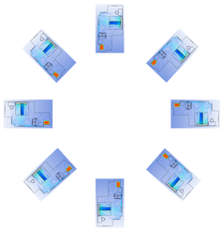
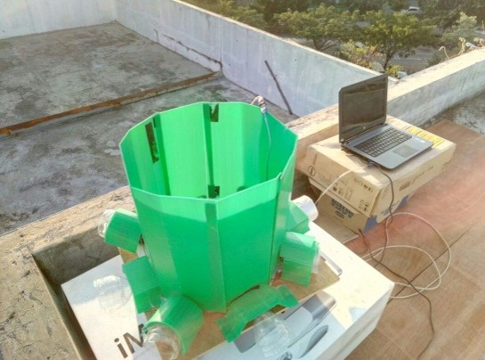
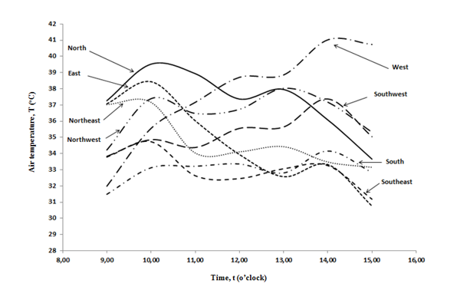
3- Usaha Penghematan Konsumsi Energi Listrik Sistem Pengkondisian Udara pada Gedung Apartemen melalui Studi Orientasi, Elevasi dan Material Bangunan (2018)
Bidang penelitian : rekayasa desain ; konsumsi energi
Tahun berlangsung : 2018
Sumber & besaran dana : Penelitian Unggulan Dana ITS (397.409.000)
Deskripsi penelitian :
Air conditioning systems constitute one kind of essential utility at a building. Electricity energy consumption for room cooler is high sufficient in fact it could attain more than half practically of electrical feeding total in the building. Air conditioning system at a room is still could be decreased its electrical cost consumption by way of insistent to continue the performance of its room air cooler. The achievement of air conditioning system mentioned is very determined to the airflow pattern inner the room which is moreover will establish air temperature, velocity, turbulence and contamination degree which is occurred inside the room. Based on the airflow pattern which is raised furthermore it will be deliberated the energy consumption which is required by the air conditioning system. Construction orientation consideration will be carried out in the framework to obtain the air conditioning system within the most economical of energy consumption which is influential to the electrical spending cost. The parameter mentioned is interesting to analyses due to the effect of sun heat will very dependent to the constructions orientation. Methodology which is to be used remains within practice the numeric simulation. The measuring of air temperature directly by means of censors also implemented within eight direction of construction orientation. The outcome of air temperature measurement will be used as the input value to the numeric simulation execution in the apartment unit with the local air conditioning system. It is obtained energy consumption of local air conditioning system in the apartment building unit within 8 (eight) orientation tremendously whilst the research variable exploration.

Slide 21
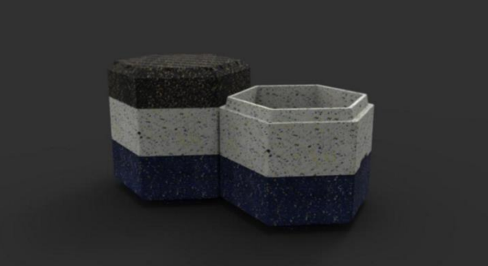
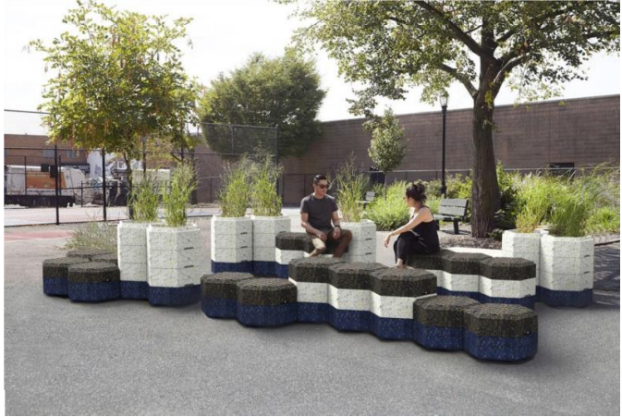
4- Pengolahan Plastik Daur Ulang sebagai Material Baru Furniture (2019)
Bidang penelitian : participatory design ; design thinking
Tahun berlangsung : 2019
Sumber & besaran dana : Dana Departemen (20.000.000)
Deskripsi penelitian :
A large amount of plastic waste in Indonesia has not been properly managed. From this phenomenon a solution is needed, namely creating a product made from plastic waste to reduce the massive amount of available plastic waste. The product that is potentially high to be developed and can make use of large amounts of plastic waste is public furniture. Considering the use of public furniture will be managed by the local government, the condition of the waste recycled products will be easier to preserve. To develop the plastic waste-based public furniture, a few procedures were carried out, such as observations to city parks, conducting interviews with the local government and with a plastic recycling company, studying the plastic physical properties, conducting experiments on the plastic waste treatment, benchmarking furniture that utilizes plastic waste, and analyzing park visitor activity. From the obtained data, an analysis of material selection was carried out based on the fulcrum strength and resistance to crack and weather. After that, the exploration of forms was carried out with the criteria of modular, sturdy, multi-configuration, and unity. The result of this study is the design of 2 in 1 public furniture (park bench and planter) which consists of 3 modules that can be arranged according to needs. One set of modules weighs 17 kgs.

Slide 22
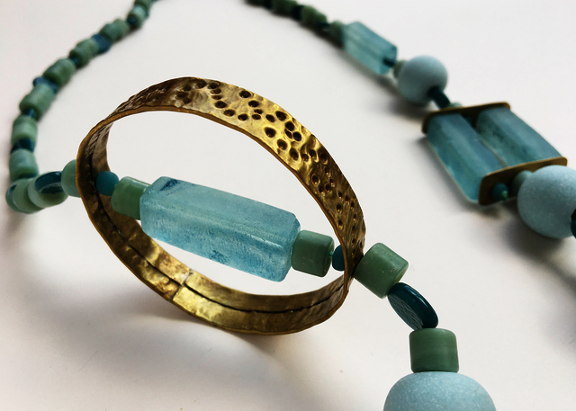
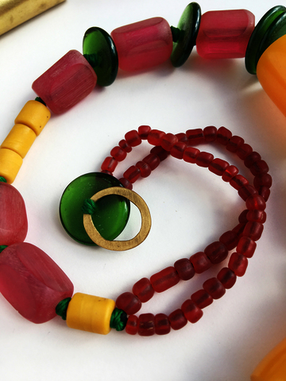

5- Telaah Efektifitas Metode Pengalaman Pengguna (Ux Research) Dalam Pengembangan Desain Produk Perhiasan
(2020)
Bidang penelitian : participatory design ; design thinking; UI/UX
Tahun berlangsung : 2020
Sumber & besaran dana : Dana Departemen (20.000.000)
Deskripsi penelitian :
This collection of jewellery artefacts made from recycled glass and metal are the outcome of an enquiry which explored how the application of co-creative design thinking strategies within a rural Indonesian community can provide creative agency for artisan craft-makers. The research is set within the context of the United Nations eighth sustainable development goal, which promotes inclusive and economic growth, employment and decent work for all. The fieldwork used Participatory Action research (PAR) methods through cumulative co-creative design activities devised by Hanson, that sought to empower by teaching design thinking through co-creative making in a collaborative shared studio/workshop environment. The workshop resulted in the co-making of 4 collections of jewellery that were documented through a project website and exhibited in Plumbon Gambang, Jombang and at ITS, Surrabaya. The project outcomes were presented at the Making Futures VI international conference; People, Place, Meaning: Crafting Social Worlds and Social Making, (19-20 September 2019) and written up into a full paper for the Making Futures Journal, volume VI published in 2020. The Making Links project was supported by a Research England, Global Challenge Research Fund grant. It built upon Dearden and Hanson’s 2017 AHRC funded grant which had established linkages and project partners.

Slide 23
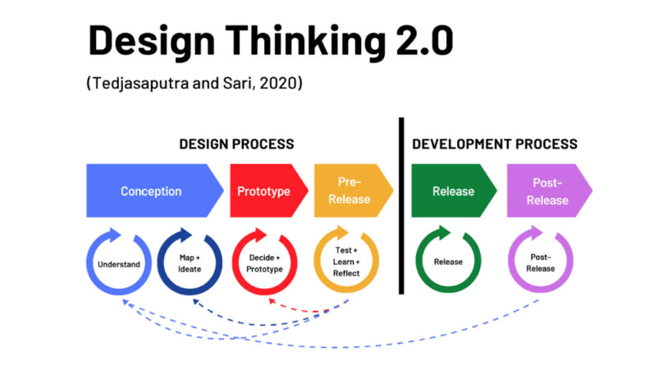
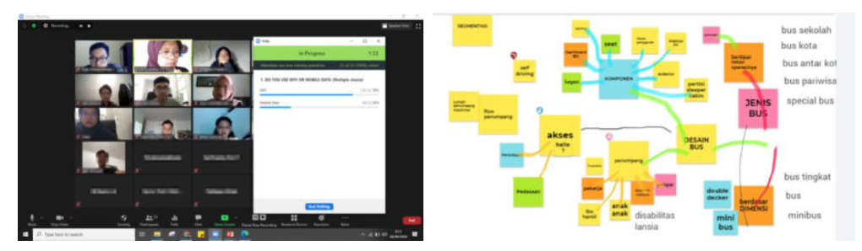
6- Keep Online Design Thinking Alive: a Case Study in Indonesia (2020)
Bidang penelitian : participatory design ; design thinking; UI/UX
Tahun berlangsung : 2020
Mitra : UX Indonesia ; Customer Experience Insight Pty Ltd (Australia)
Deskripsi penelitian :
COVID-19 pandemic has disrupted the way teaching and learning conducted in tertiary education institutions, including in Indonesia. The pandemic has not yet finished; thus, education institutions need to consider this disruption as a long-term situation and therefore need to make a significant adjustment. Design Thinking has been used for a long time to solve complex problems, but there has not been any comprehensive implementation of Design Thinking in tertiary education. In this study, we present some of the ongoing research we conducted since last year in Cohort 1 to critically evaluate and redefine the UX Design Research course delivered by the Industrial Design Department of a state university in Indonesia. The intervention of the Design Thinking framework, the so-called Design Thinking 2.0, has led to significant changes in the course and gradually improved the teaching and learning in Cohorts 2 and 3. Authentic learning goals and appropriate support mechanisms have provided sustainable improvement of the course.

Slide 24
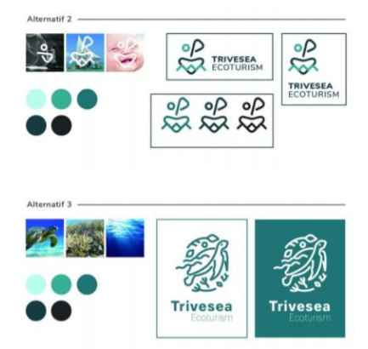
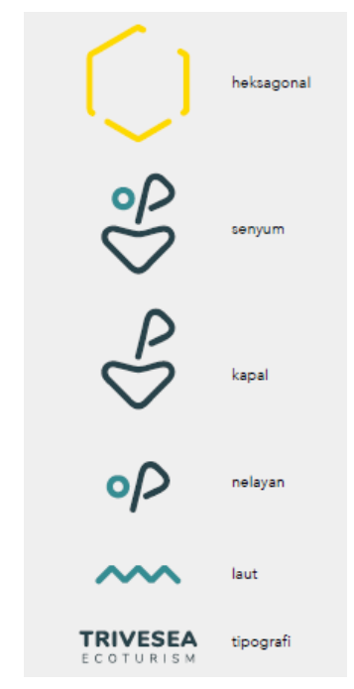

7- Desain Model Pariwisata Bahari Berbasis Masyarakat (2019 - 2021)
Bidang penelitian : participatory design ; design thinking; UI/UX
Tahun berlangsung : 2019 - 2021
Sumber & besaran dana : KRU PT Dikti (300.000.000)
Deskripsi penelitian :
Kepariwisataan merupakan salah satu sektor perekonomian yang menyumbang devisa terbesar di Indonesia. Indonesia sebagai negara kepulauan terbesar di dunia memiliki garis pantai yang terbentang panjang dan sangat potensial dalam pengembangan kawasan ekowisata berbasis kemaritiman. ITS sebagai kampus dengan orientasi penelitian dalam bidang kemaritiman mengembangkan bentuk penerapan teknologi akuakultur Ocean-Farm ITS dengan penambahan fungsi sebagai area ekowisata terapung baru lepas pantai. Keberlanjutan dalam penelitian tersebut membutuhkan sebuah solusi dalam memperkenalkan jenis wisata baru dan inovatif sehingga mampu meningkatkan perekonomian daerah dimana teknologi Ocean-Farm ITS diaplikasikan. Dalam tulisan ini, penulis akan menjelaskan tentang solusi identitas visual sebagai sebuah cara dalam memperkenalkan ekowisata baru.

Slide 25
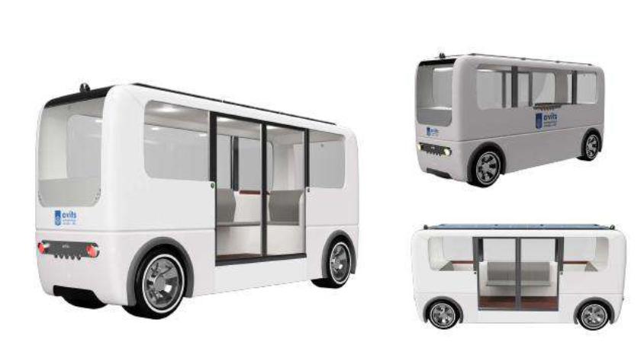
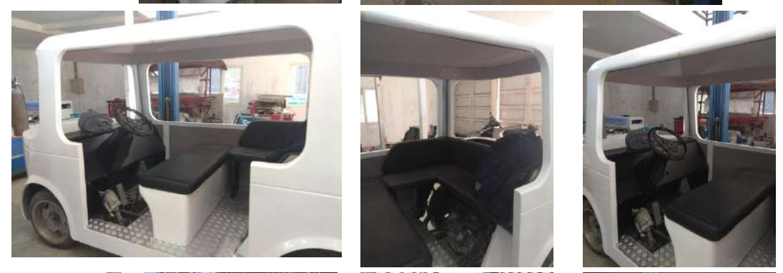
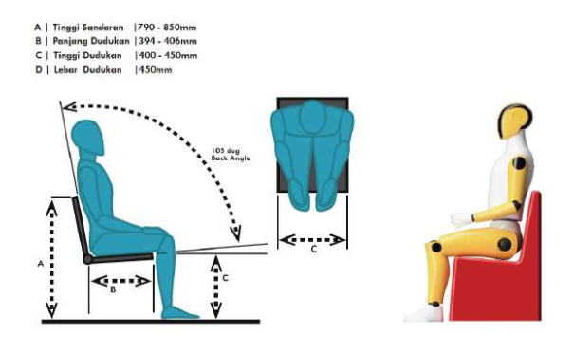
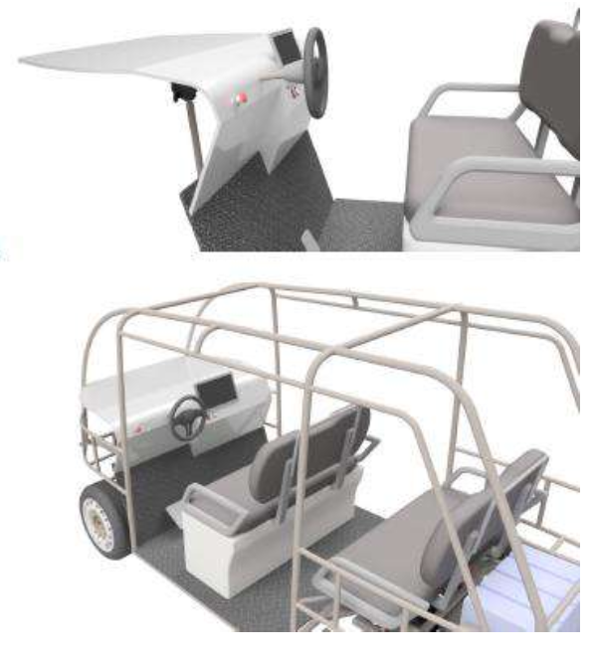
8- Desain Interior dan Human Factors iCar ITS (2020)
Bidang penelitian : desain transportasi (geometri, rekayasa desain)
Tahun berlangsung : 2020
Sumber & besaran dana : Penelitian Unggulan Dana ITS (110.000.000)
Deskripsi penelitian :
Kebutuhan moda transportasi yang ramah lingkungan (environmentally friendly) di area perkotaan pada saat ini semakin meningkat.Pemerintah telah mengeluarkan kebijakan melalui Perpres Nomor 55 Tahun 2019, tentang percepatan Program Kendaraan Bermotor Listrik Berbasis Baterai untuk transportasi jalan, dimana Tingkat Kandungan Dalam Negeri (TKDN) industri manufaktur nasional diharapkan setiap tahun meningkat mulai 30% - 78% untuk mendapatkan pembebasan pajak bea masuk dan barang mewah dan mengurangi konsumsi BBM bersubsidi. Energi listrik menjadi energi alternatif yang ramah lingkungan yang terbarukan dimana dapat diimplementasikan pada moda transportasi roda 2, 3 dan 4 di area perkotaan khususnya lingkungan ITS. Hanya saja permasalahan saat ini adalah belum dikuasainya teknologi rancang bangun prototyping Electric Vehicle yang diproduksi oleh industri dalam negeri dan kurangnya moda Transportasi pada kawasan terbatas yang ramah lingkungan, untuk mengurangi tingkat polusi udara yang semakin mengkhawatirkan. iCar hadir menjawab permasalahan tersebut untuk mewujudkan riset inovatif produktif, menunjang rancang bangun prototyping Electric Bike/Tricycle/Car untuk menunjang industri dalam negeri, pada penelitian ini lebih fokus pada i-car ITS. luaran penelitian ini antara lain penyusunan Roadmap Riset Kendaraan Listrik, Product Planning, Basic Design (General Arangement, Technical Specification, Design Requirements & Objectives (DR&O), Human Factors Engineering & Ergonomics, Conceptual Design, Preliminary Design, Scaled Model 1:5 – 1:8, Animation (Product Assy), Publication, Pemeran Nasional, HKI (Paten, Desain Industri), Testing (Structural Mechanical Testing).

Slide 26
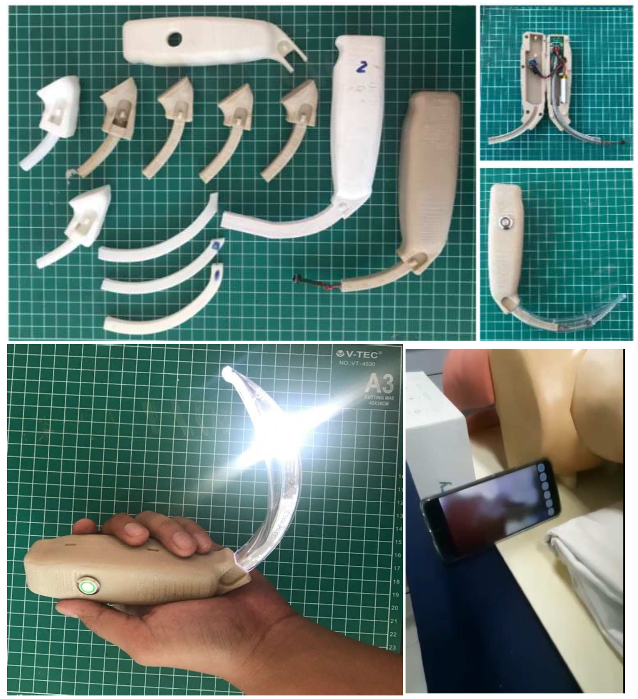
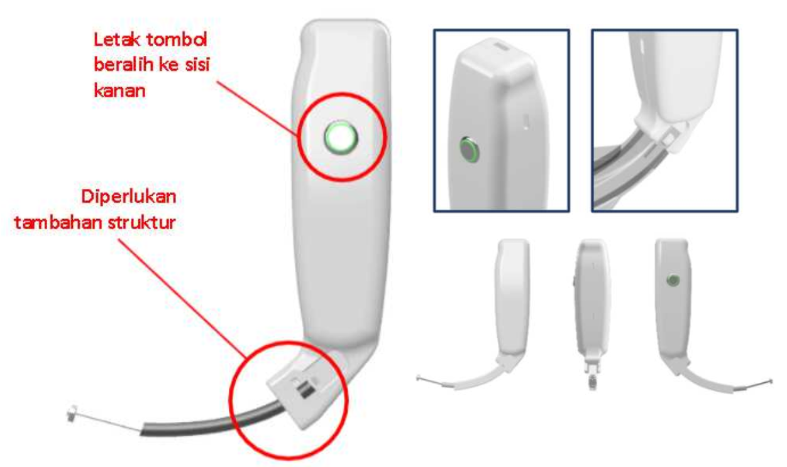
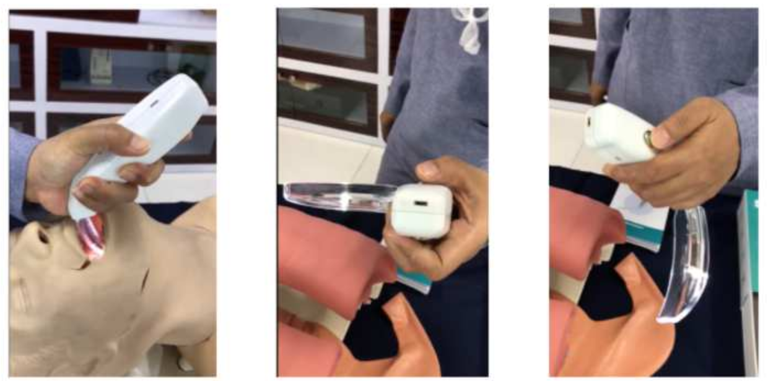
9- Pengembangan Prototype dan Uji Klinik Smart Laryngoscope (kolaborasi dengan Lab SDM 2021)
Bidang penelitian : health care, ergonomi fisik dan kognitif
Tahun berlangsung : 2021
Sumber & besaran dana : Penelitian Kolaborasi Pusat ITS (50.000.000)
Deskripsi penelitian :
Prototype hasil riset 2020 mendapat banyak masukan dari tim medis berpengalaman penanganan pasien selama masa pandemi ini khususnya pada fase intubasi. Tindakan intubasi ini berpotensi besar memberikan risiko penularan dari mulut pasien ke dokter Spesialis Anestesiologi dan Terapi intensif. Di lain sisi, apabila tindakan medis ini tidak dilakukan, maka pasien sangat berpotensi mengalami cedera miokard dan adanya kegagalan organ, yang menyebabkan ketidakstabilan themodinamik bersamaan dengan saturasi oksigen rendah yang berujung pada kematian. Permasalahan yang terjadi adalah belum terdefinisinya material yang sesuai dengan karakteristik dan performa smart laryngoscope, Belum definitif dilakukan pengujian untuk produksi smart laryngoscope. Perlunya branding, Packaging Smart Laryngoscope sebagai pengembangan produk kearah komersialisasi. Tujuan riset ini adalah mendefinisikan material yang sesuai dengan karakteristik dan performa smart laryngoscope untuk pasien Covid-19 dengan melakukan analisa engineering serta serangkaian pengujian klinis, Pembuatan mould untuk produksi massal smart laryngoscope Covid-19, Terdefinisinya konsep branding dan desain packaging Smart Laryngoscope untuk persiapan komersialisasi produk. Pengembangan Prototype dan Pengujian Desain Smart Laryngoscope generasi 2 dilaksanakan dengan metodologi Riset yang menggabungkan kompetensi desain produk, keilmuan medis, metode bidang biomedi. Hasil dan luaran riset meliputi: 3D Digital Prototipe, mockup , Video Animasi Operasional, Dokumen Pengujian, buku panduan operasional & perawatan, serta draft hak kekayaan intelektual (HKI)

Slide 27
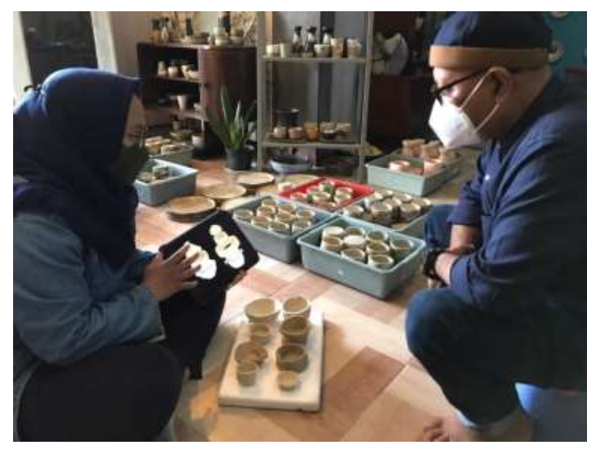
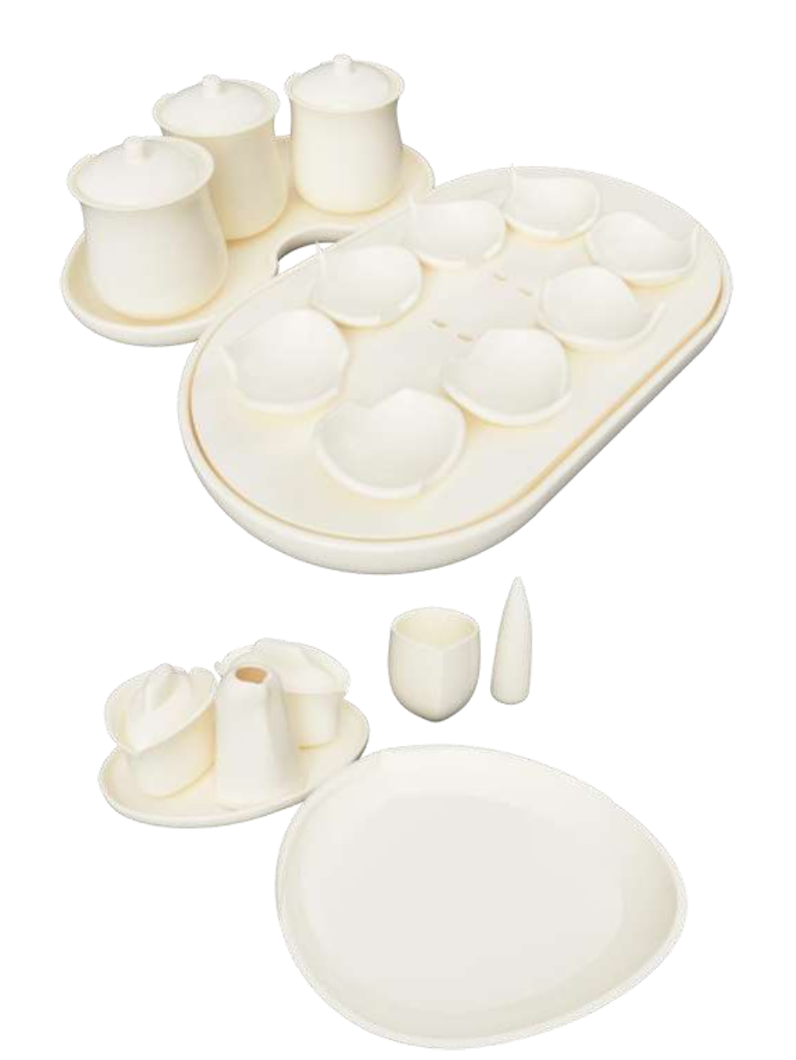
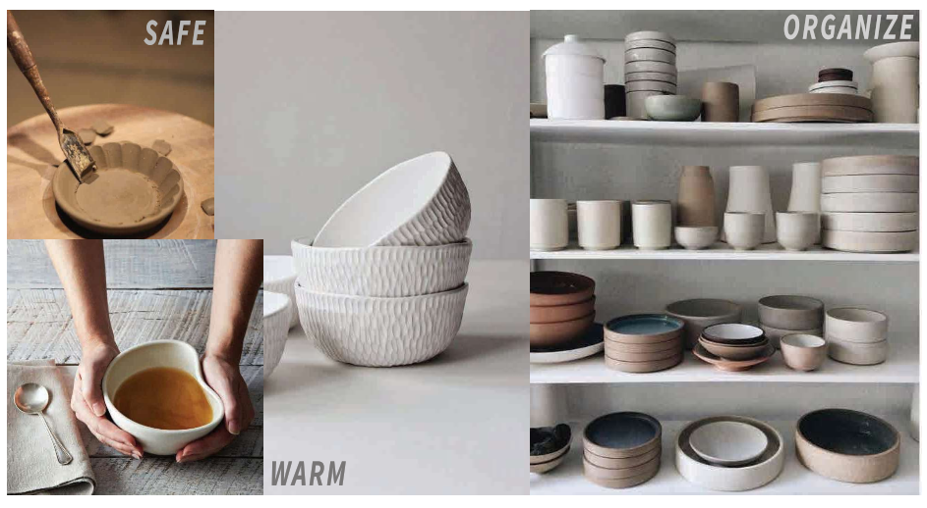
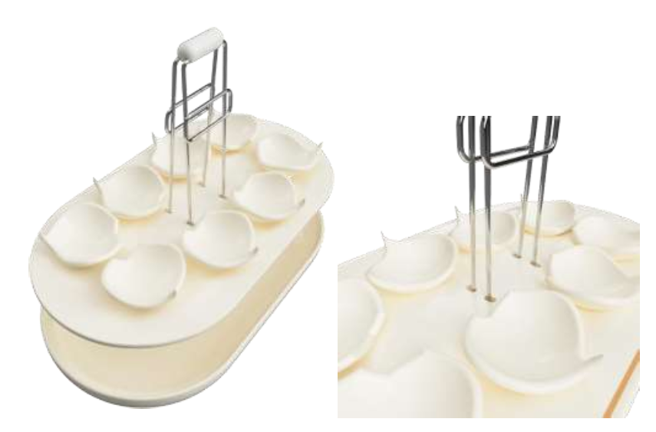
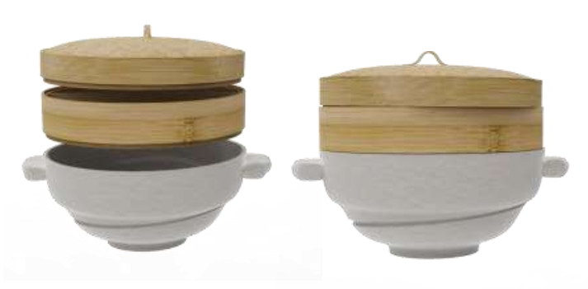
10- Pengembangan Desain Innovative Dinnerware untuk Menunjang Gastronomy Tourism (2021)
Bidang penelitian : culture, participatory design, design thinking
Tahun berlangsung : 2021
Sumber & besaran dana : Penelitian Kemitraan Dana ITS (50.000.000)
Deskripsi penelitian :
Desain dinnerware telah berkembang pesat dengan berbagai bentuk dan inovasi. Produk dinnerware dapat digunakan sebagai sarana pendukung untuk memajukan wisata di bidang kuliner yang merupakan salah satu dari industri kreatif dengan kontribusi terbesar terhadap pendapatan negara termasuk di Indonesia yang memiliki berbagai kekayaan kuliner. pengembangan produk dinnerware berbasis pada budaya Indonesia yang dapat menjaga kualitas makanan secara optimal, sekaligus memberikan peluang untuk memajukan industri kuliner serta produsen dinnerware yaitu industri keramik. Dengan menganalisis karakteristik beberapa jenis makanan khas Indonesia seperti pecel dan bakso, kemudian melakukan studi perilaku pengguna seperti kebiasaan serta suasana emosional yang dialami. Hasil studi tersebut menghasilkan daftar kebutuhan desain, Selanjutnya dilakukan studi eksplorasi bentuk untuk diujikan kepada pengguna serta pemilik industri kuliner. Konsep produk yang akan dikembangkan pada penelitian ini ialah dinnerware dengan konsep gastronomy tourism untuk mendukung wisata kuliner. Produk dinnerware didesain agar makanan tersaji dengan cara yang berbeda dan memberikan pengalaman baru pada pengguna.

Slide 28

Mitra Kerjasama

Slide 29
Notable Researcher
Ellya Zulaikha, S.T., M.Sn., Ph.D
Educational Background :
2010 - 2015 Doctor of Philosophy (Collaborative Design Learning), Queensland University of Technology (QUT), Brisbane, Australia
Focus: Collaborative Design Learning in the Rural Craft Industry.
Ellya Zulaikha is an Associate Professor in Industrial Design Department, Vice Dean, Faculty of Creative Design and Digital Business at ITS Surabaya, Indonesia. Ellya has rich experience in teaching and research activities, mainly in the field of design including: creativity, design method, community engagement using design approach (Participatory Design). Design thinking and its application in many field of interdisciplinary cases is her interest. Ellya involved in some community service program, such as board member in designing implementation of Cluster Development Center for the Creative Economy Product Design Subsector and Visual Communication Design Subsector, Product Design Development Facilitation Program in some regencies in East Java in 2014 – 2015, and intensively involved in the community development of Glass Craft Design using Participatory Design Method for Glass Bead Craftsmen in Kec. Gudo, Jombang, East Java. For research capability, Ellya has experience in design research related to human centered design field implemented in medical equipment design (Portable Indirect Ophthalmoscopy Fabrication, Respiratory Supporting Device, Electric Wheelcair for difable), in plastic recycling as street furniture, and utilization of natural fiber waste. Besides, Ellya involved as a co-researcher in a research program: “Making Link : Sustaining links with the Indonesian Craft Economy” with Sheffield Hallam University researcher, funded by Arts and Humanities Research Council (AHRC) – UK since 2017 – 2020.

