Slide 1



IKABITS
www.its.ac.id/biologi
biologi_its
Biologi ITS
Biologi ITS
Biologi ITS

Slide 2
KEPROFESIAN
www.its.ac.id/biologi
biologi_its
Biologi ITS

Slide 3


Profesi Alumni Biologi
Biologist
Lab Technician
Teacher
Lecture
Veterinarian
Biomedical
Enginerer
Wildlife biologist
Microbiologist
Biotechnologist
Epidemiologist
Ecologist
Researcher
Content Writer
Science Writer
Biostatistician
Environment Consultant
Natural Conservation Officer
Forensic Scientist
Government Agency Roles
Conservation Biologist
Zoo Biologist
Content Creator
Environment Manager
Marine Biologist
Genetic Engineering
Plantation Research Development
Bioinformatics Scientists
Enterprener
Inspector
Consultant
www.its.ac.id
INSTITUT TEKNOLOGI SEPULUH NOPEMBER, Surabaya - Indonesia

Slide 4
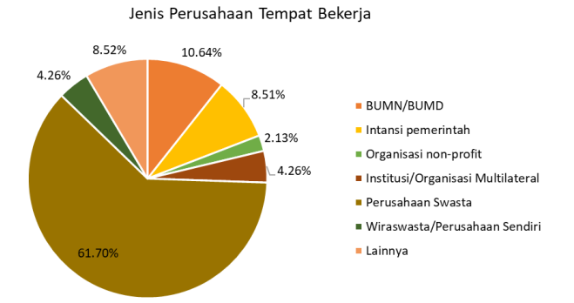
Profesi Alumni Biologi
https://www.its.ac.id/careers/id/layanan/tracer-study/
www.its.ac.id
INSTITUT TEKNOLOGI SEPULUH NOPEMBER, Surabaya - Indonesia

Slide 5

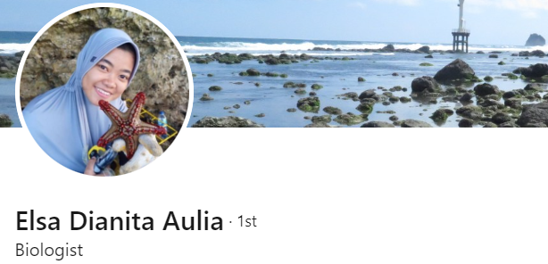

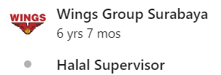




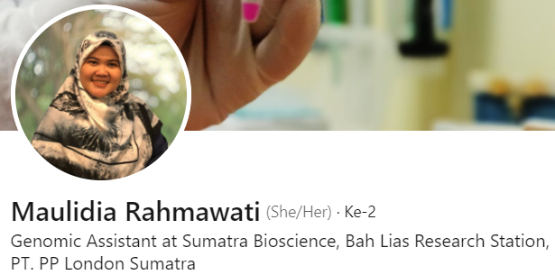

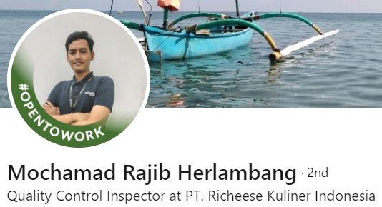
Profesi Alumni Biologi ITS
www.its.ac.id
INSTITUT TEKNOLOGI SEPULUH NOPEMBER, Surabaya - Indonesia

Slide 6
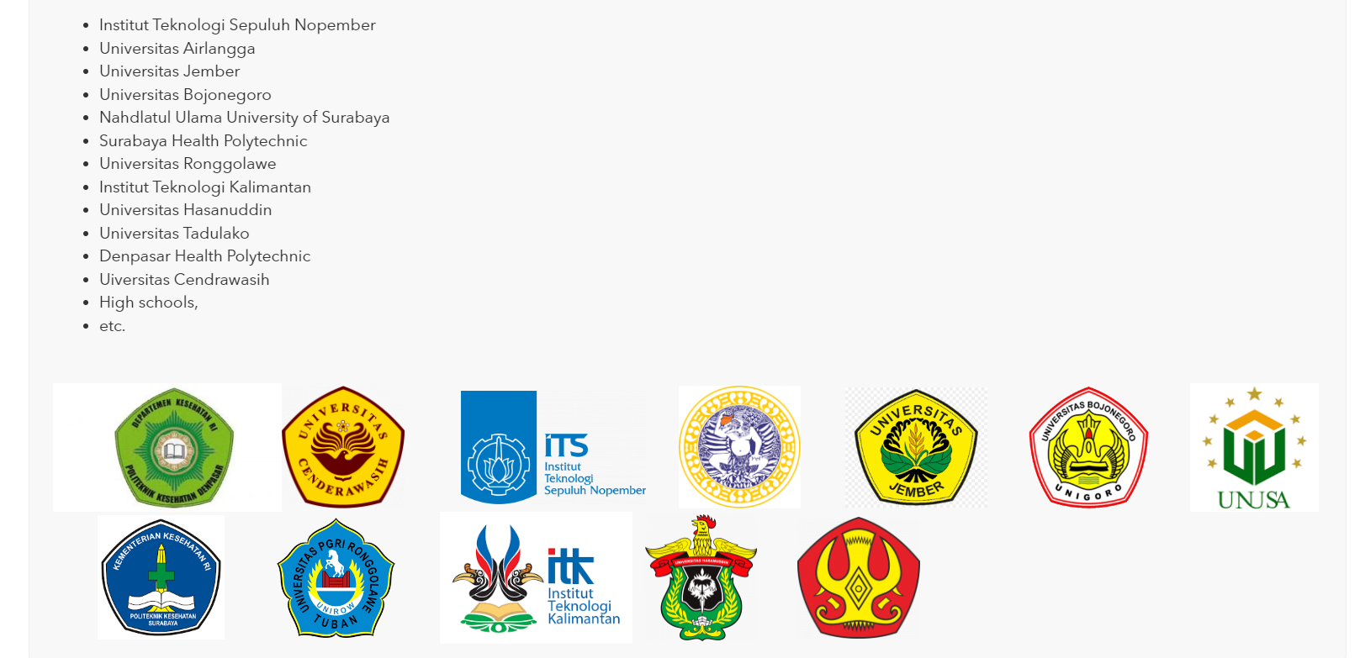
Profesi Alumni sebagai Dosen
www.its.ac.id
INSTITUT TEKNOLOGI SEPULUH NOPEMBER, Surabaya - Indonesia

Slide 7
Jabatan Profesi Alumni Biologi ITS
Direktur
Manajer
Research & Development
Microbiologist
Quality Control
HRD
www.its.ac.id
INSTITUT TEKNOLOGI SEPULUH NOPEMBER, Surabaya - Indonesia

Slide 8




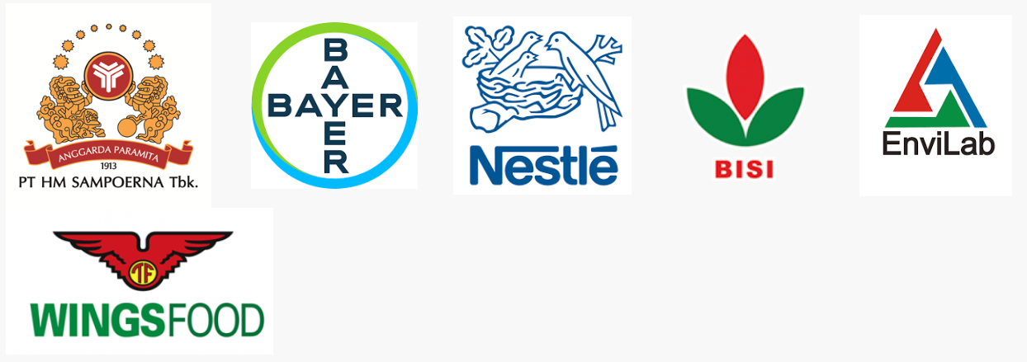




Perusahaan Tempat Alumni Biologi ITS Bekerja
www.its.ac.id
INSTITUT TEKNOLOGI SEPULUH NOPEMBER, Surabaya - Indonesia

Slide 9
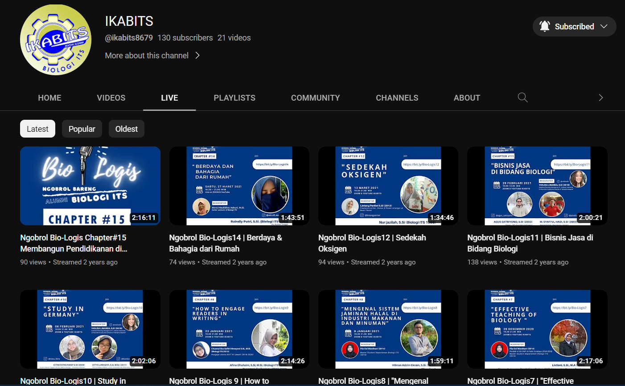
Profesi Alumni Biologi ITS
https://youtube.com/@ikabits8679?si=W4SXu-8JweWOaHxb
www.its.ac.id
INSTITUT TEKNOLOGI SEPULUH NOPEMBER, Surabaya - Indonesia

Slide 10
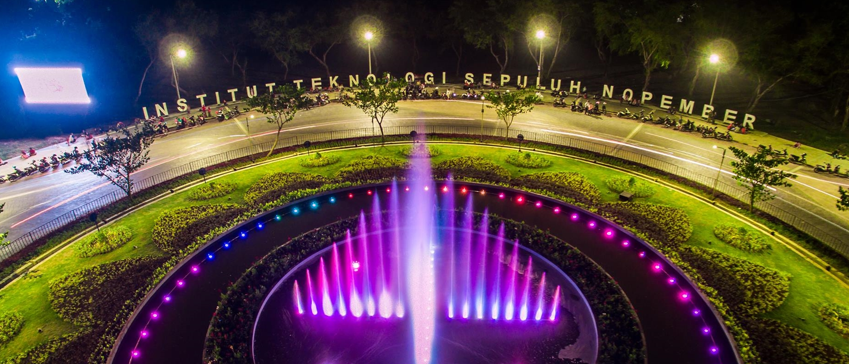
TERIMA KASIH
GAMBAR BISA DIGANTI / DIHAPUS

