Slide 1
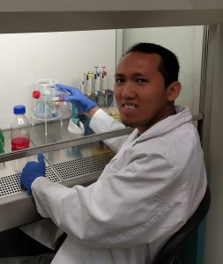
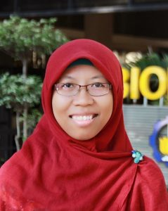
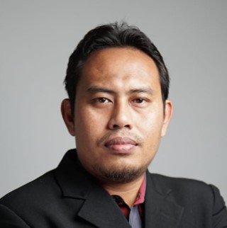
Head of Department
Dr. Dewi Hidayati, S.Si., M.Si.
Deputy Head of Department
Deputy Head of Department
Head of Master Program
Aunurohim, S.Si., DEA
Dr. Nurul Jadid, S.Si., M.Sc.
Dr. Awik Puji Dyah Nurhayati
Head of Bioscience and Plant Technology Laboratory
Head of Microbiology and Biotecnology Laboratory
Head of Zoology and Animal Engineering Laboratory
Head of Ecology
Laboratory
Student Advisor Coordinator
Dr. Tutik Nurhidayati, S.Si., M.Si.
Dr.rer.nat Arif Luqman, S.Si., M.T.
Dr. rer. nat. Edwin Setiawan
Indah Trisnawati D.T, M.Si, Ph.D
Nova Maulidina A, S.Si., M.Si.
Sub-division Head
Murdiono, S.Kom.

